Slide 1
The solid experience
User perceptions and behaviour unveiled
By August Bourgeus

Slide 2
August Bourgeus
Researcher
SolidLab Flanders
Imec-SMIT-VUB
August.Bourgeus@vub.be

Slide 3
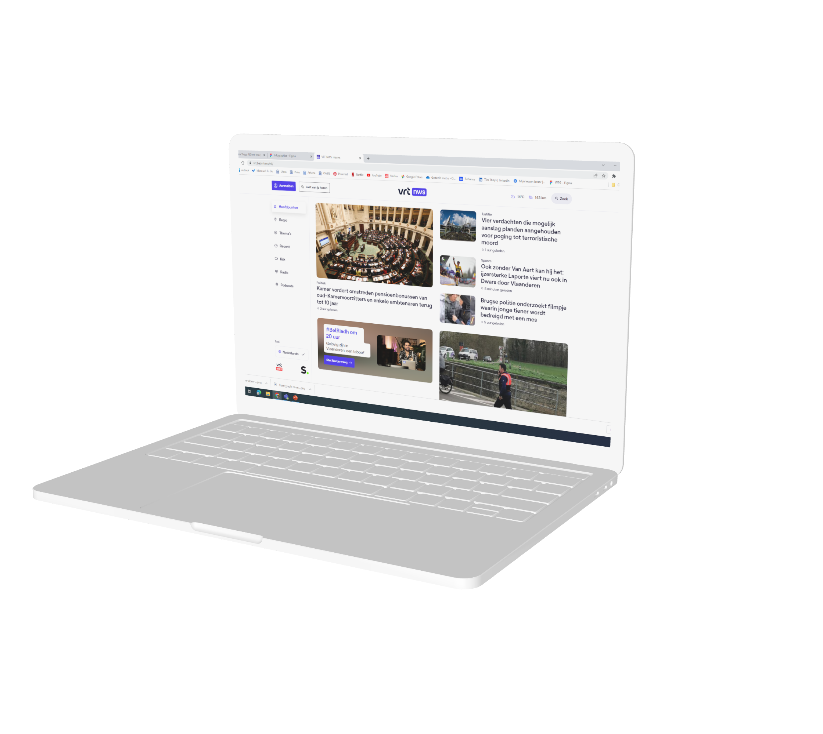
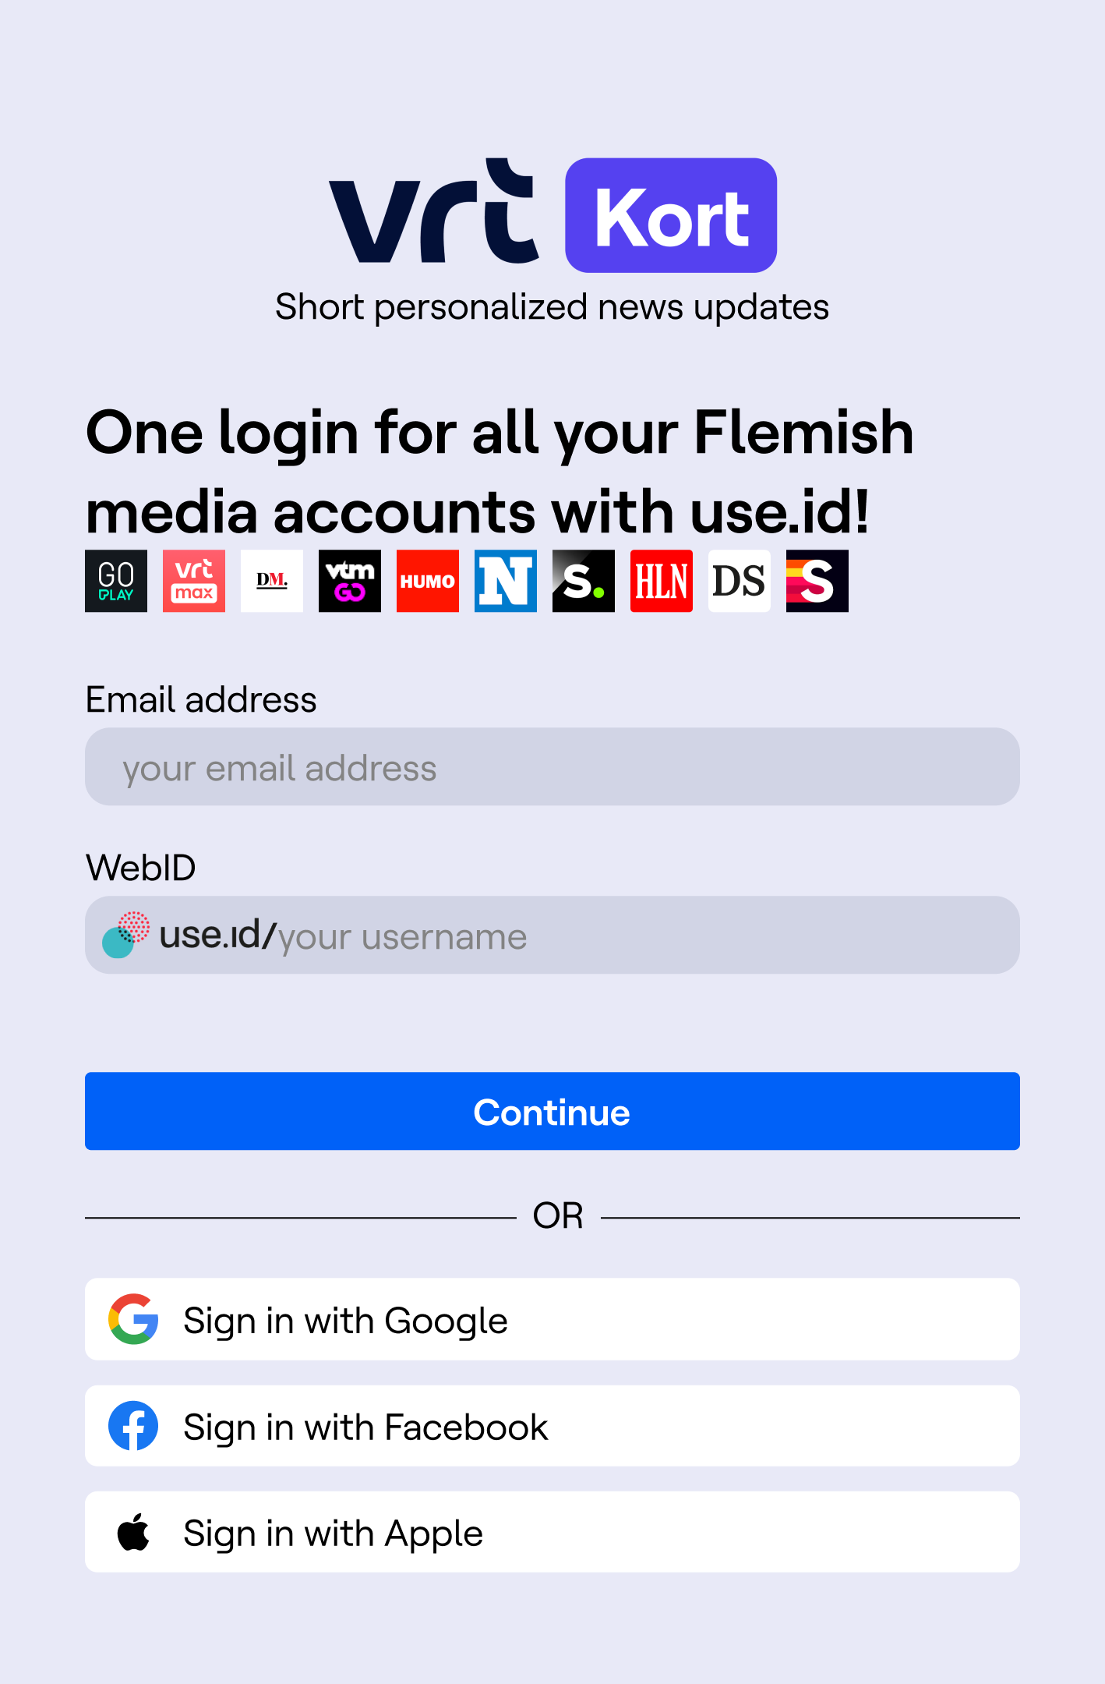
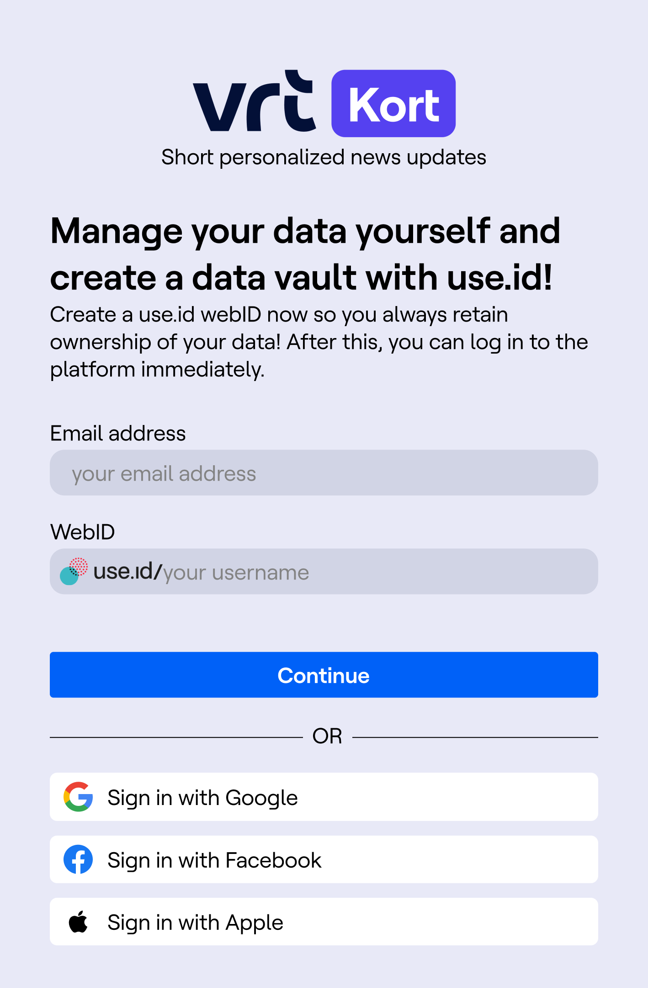
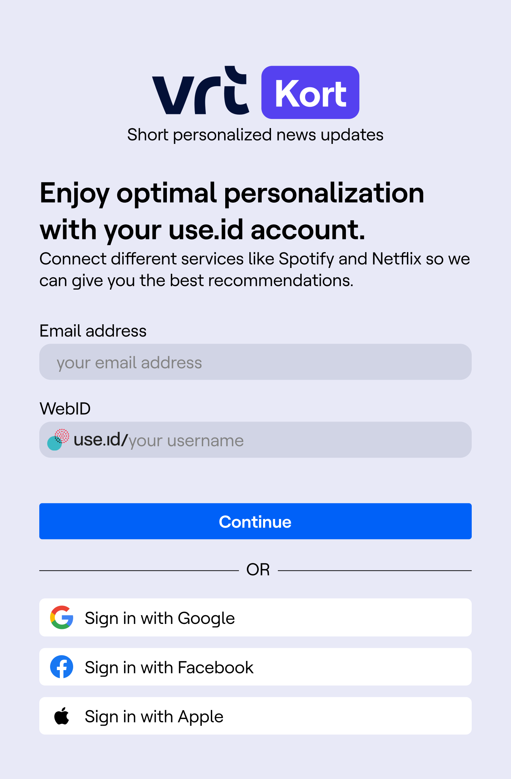
Results of two consecutive experiments
1) How does a data vault integration in the news website of the public broadcaster affect the user experience?
2) How can we heighten the users’ intention to use Solid?
Notes:
Today I’ll present the results of two experiments that were conducted last year.
I’ll start with presenting the results of an experiment in which we explored the effects of the integration of a datavault into a news website
And secondly, I’ll present an experiment in which we dove a bit deeper into factors impacting the adoption of Solid by end users.

Slide 4
How does a data vault integration in the news website of the public broadcaster affect the user experience?
Notes:
Let’s start with the integration a data vault into a news website.

Slide 5
Test case
The user receives personalized news recommendations based on his/her reading behavior.
Notes:
So for this experiment we started from a use case in which people received personalized news article recommendations based on their previous reading behavior. The algorithm was very simple, since this was not what we were trying to test here and just pushed articles from a certain category more to the top if people had read similar articles before.

Slide 6
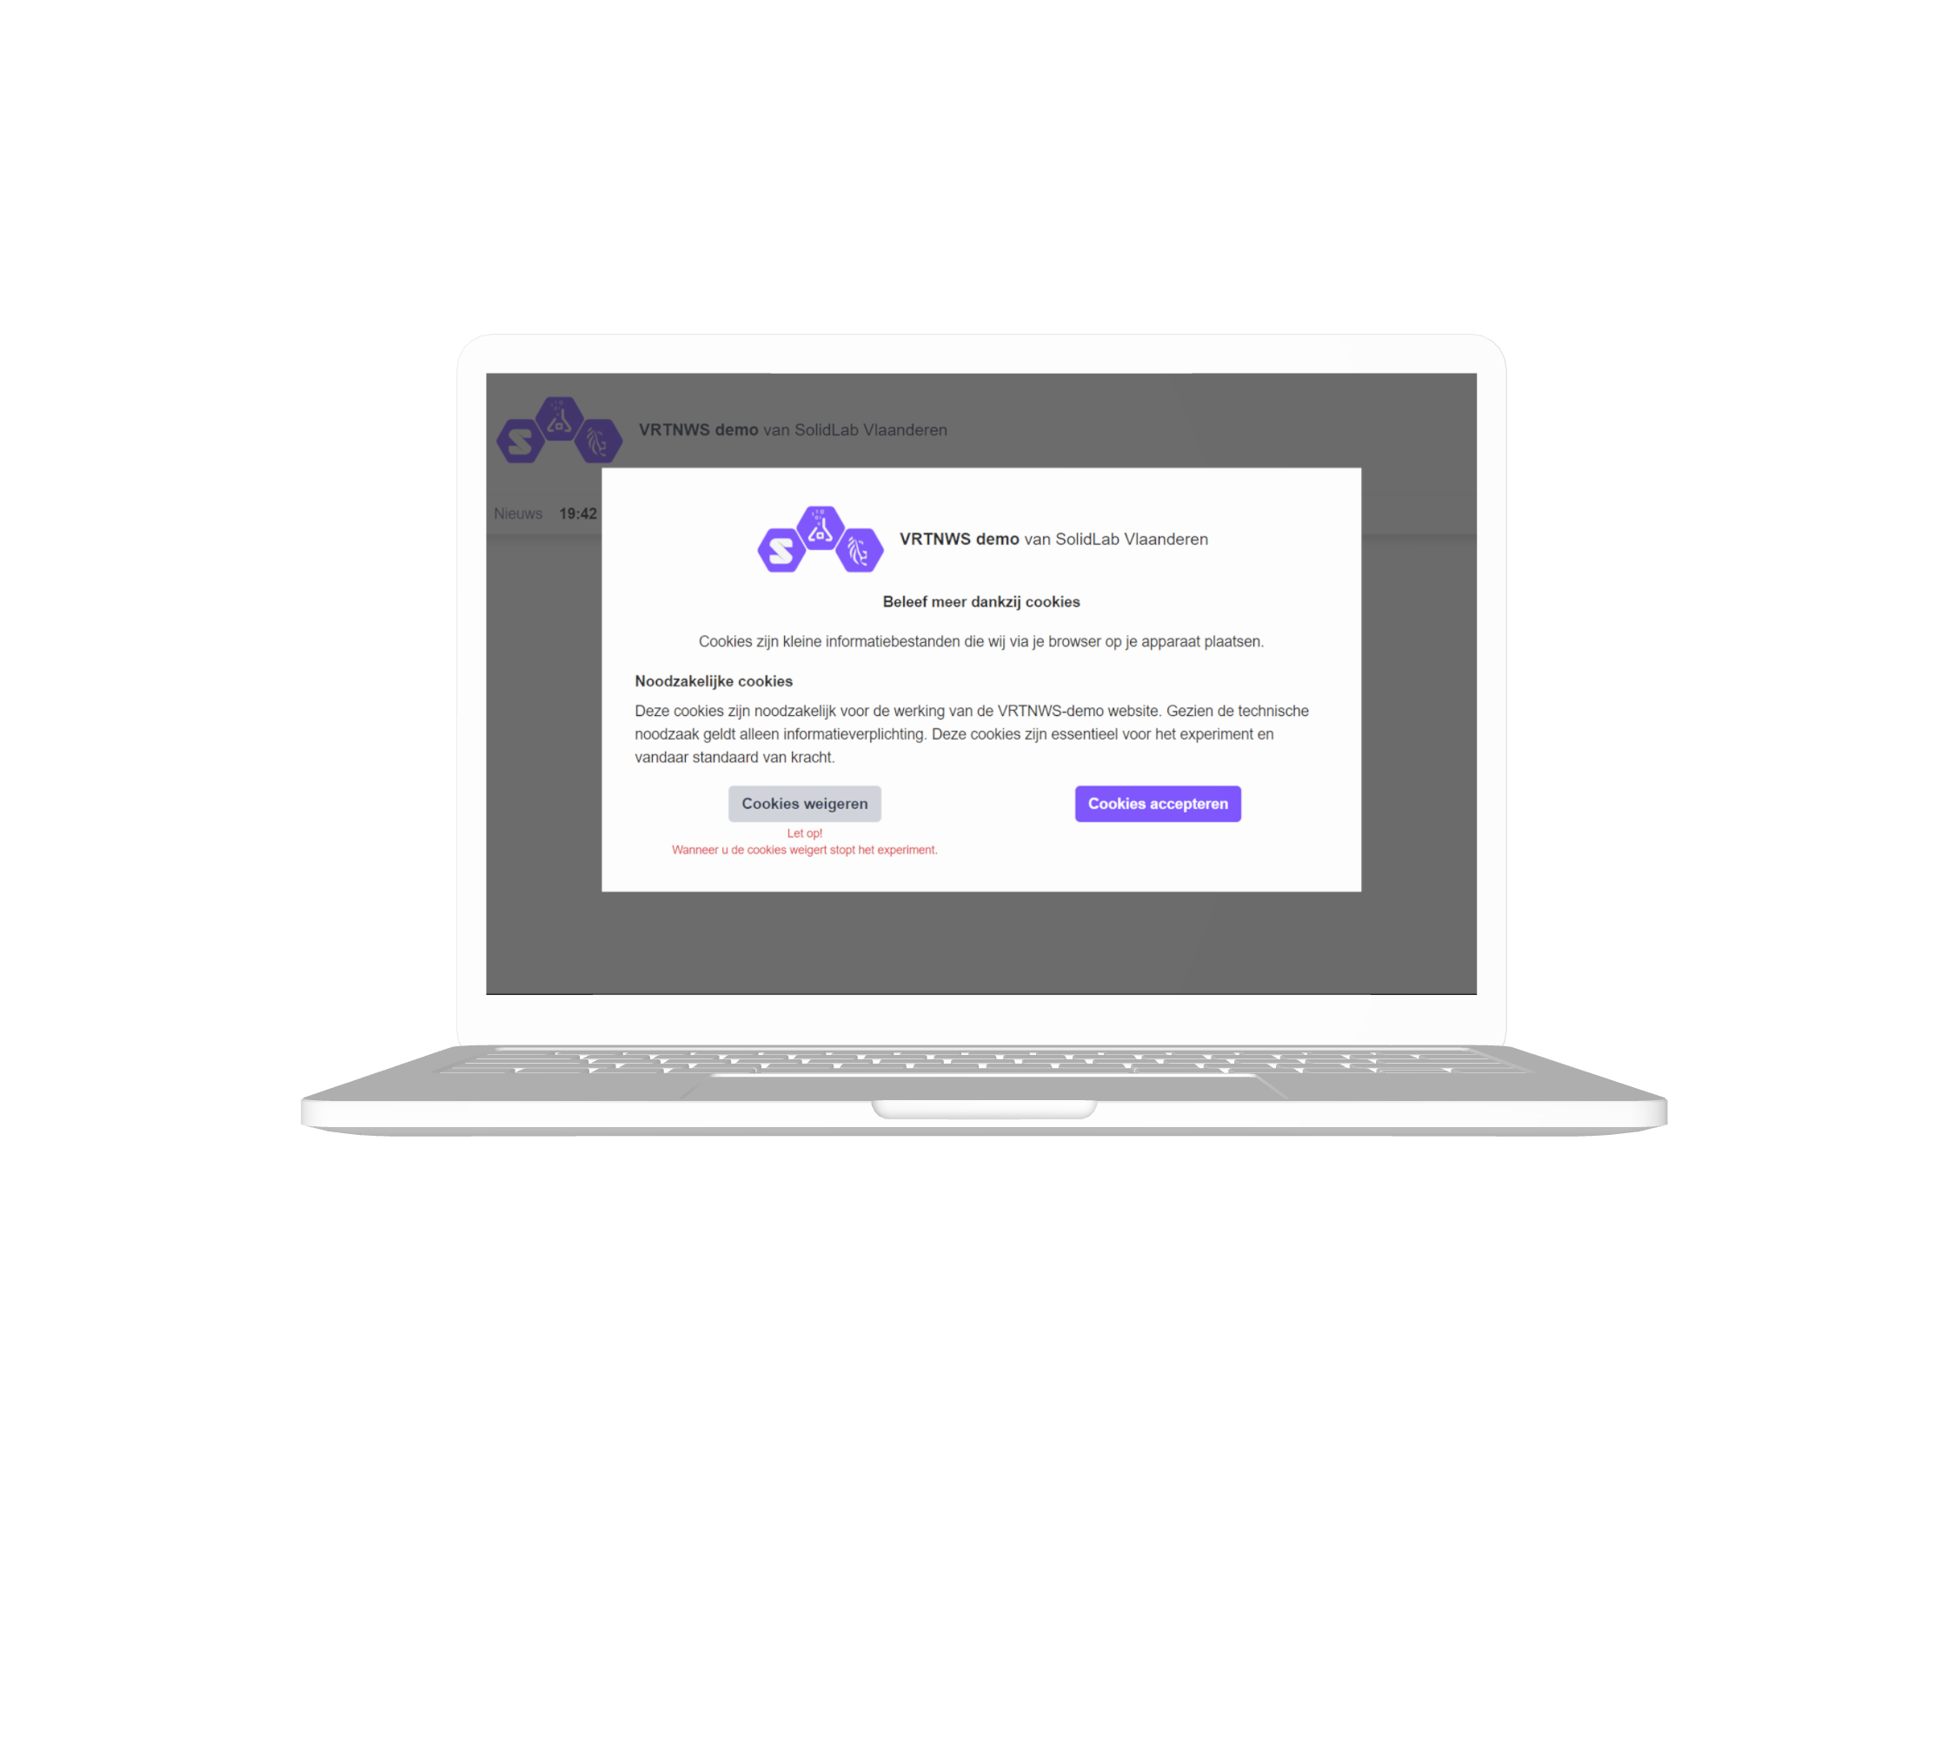
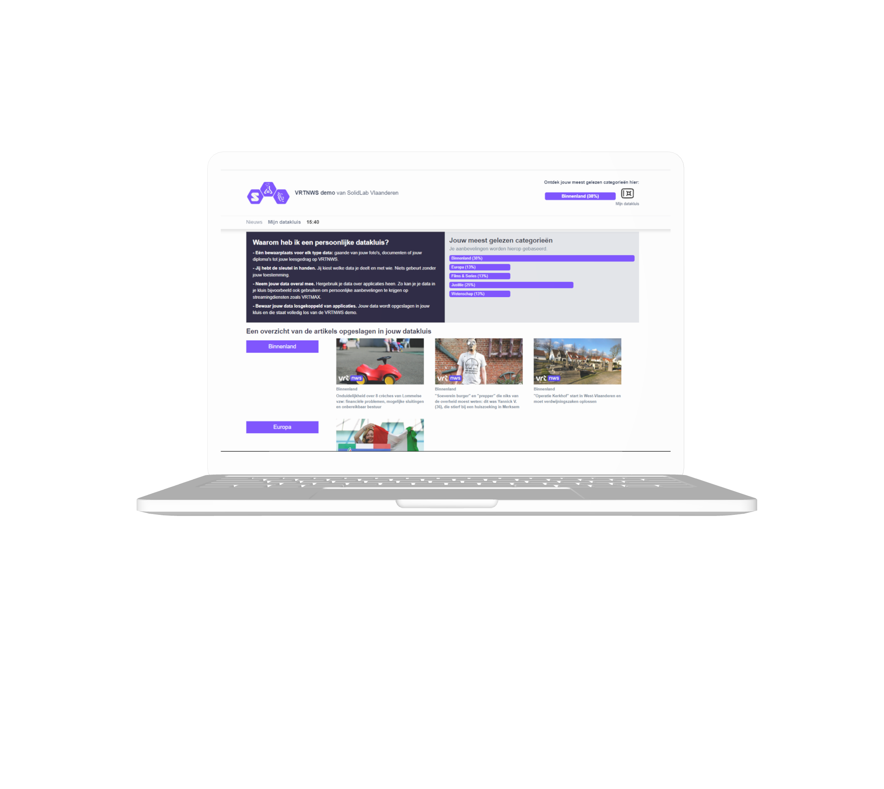
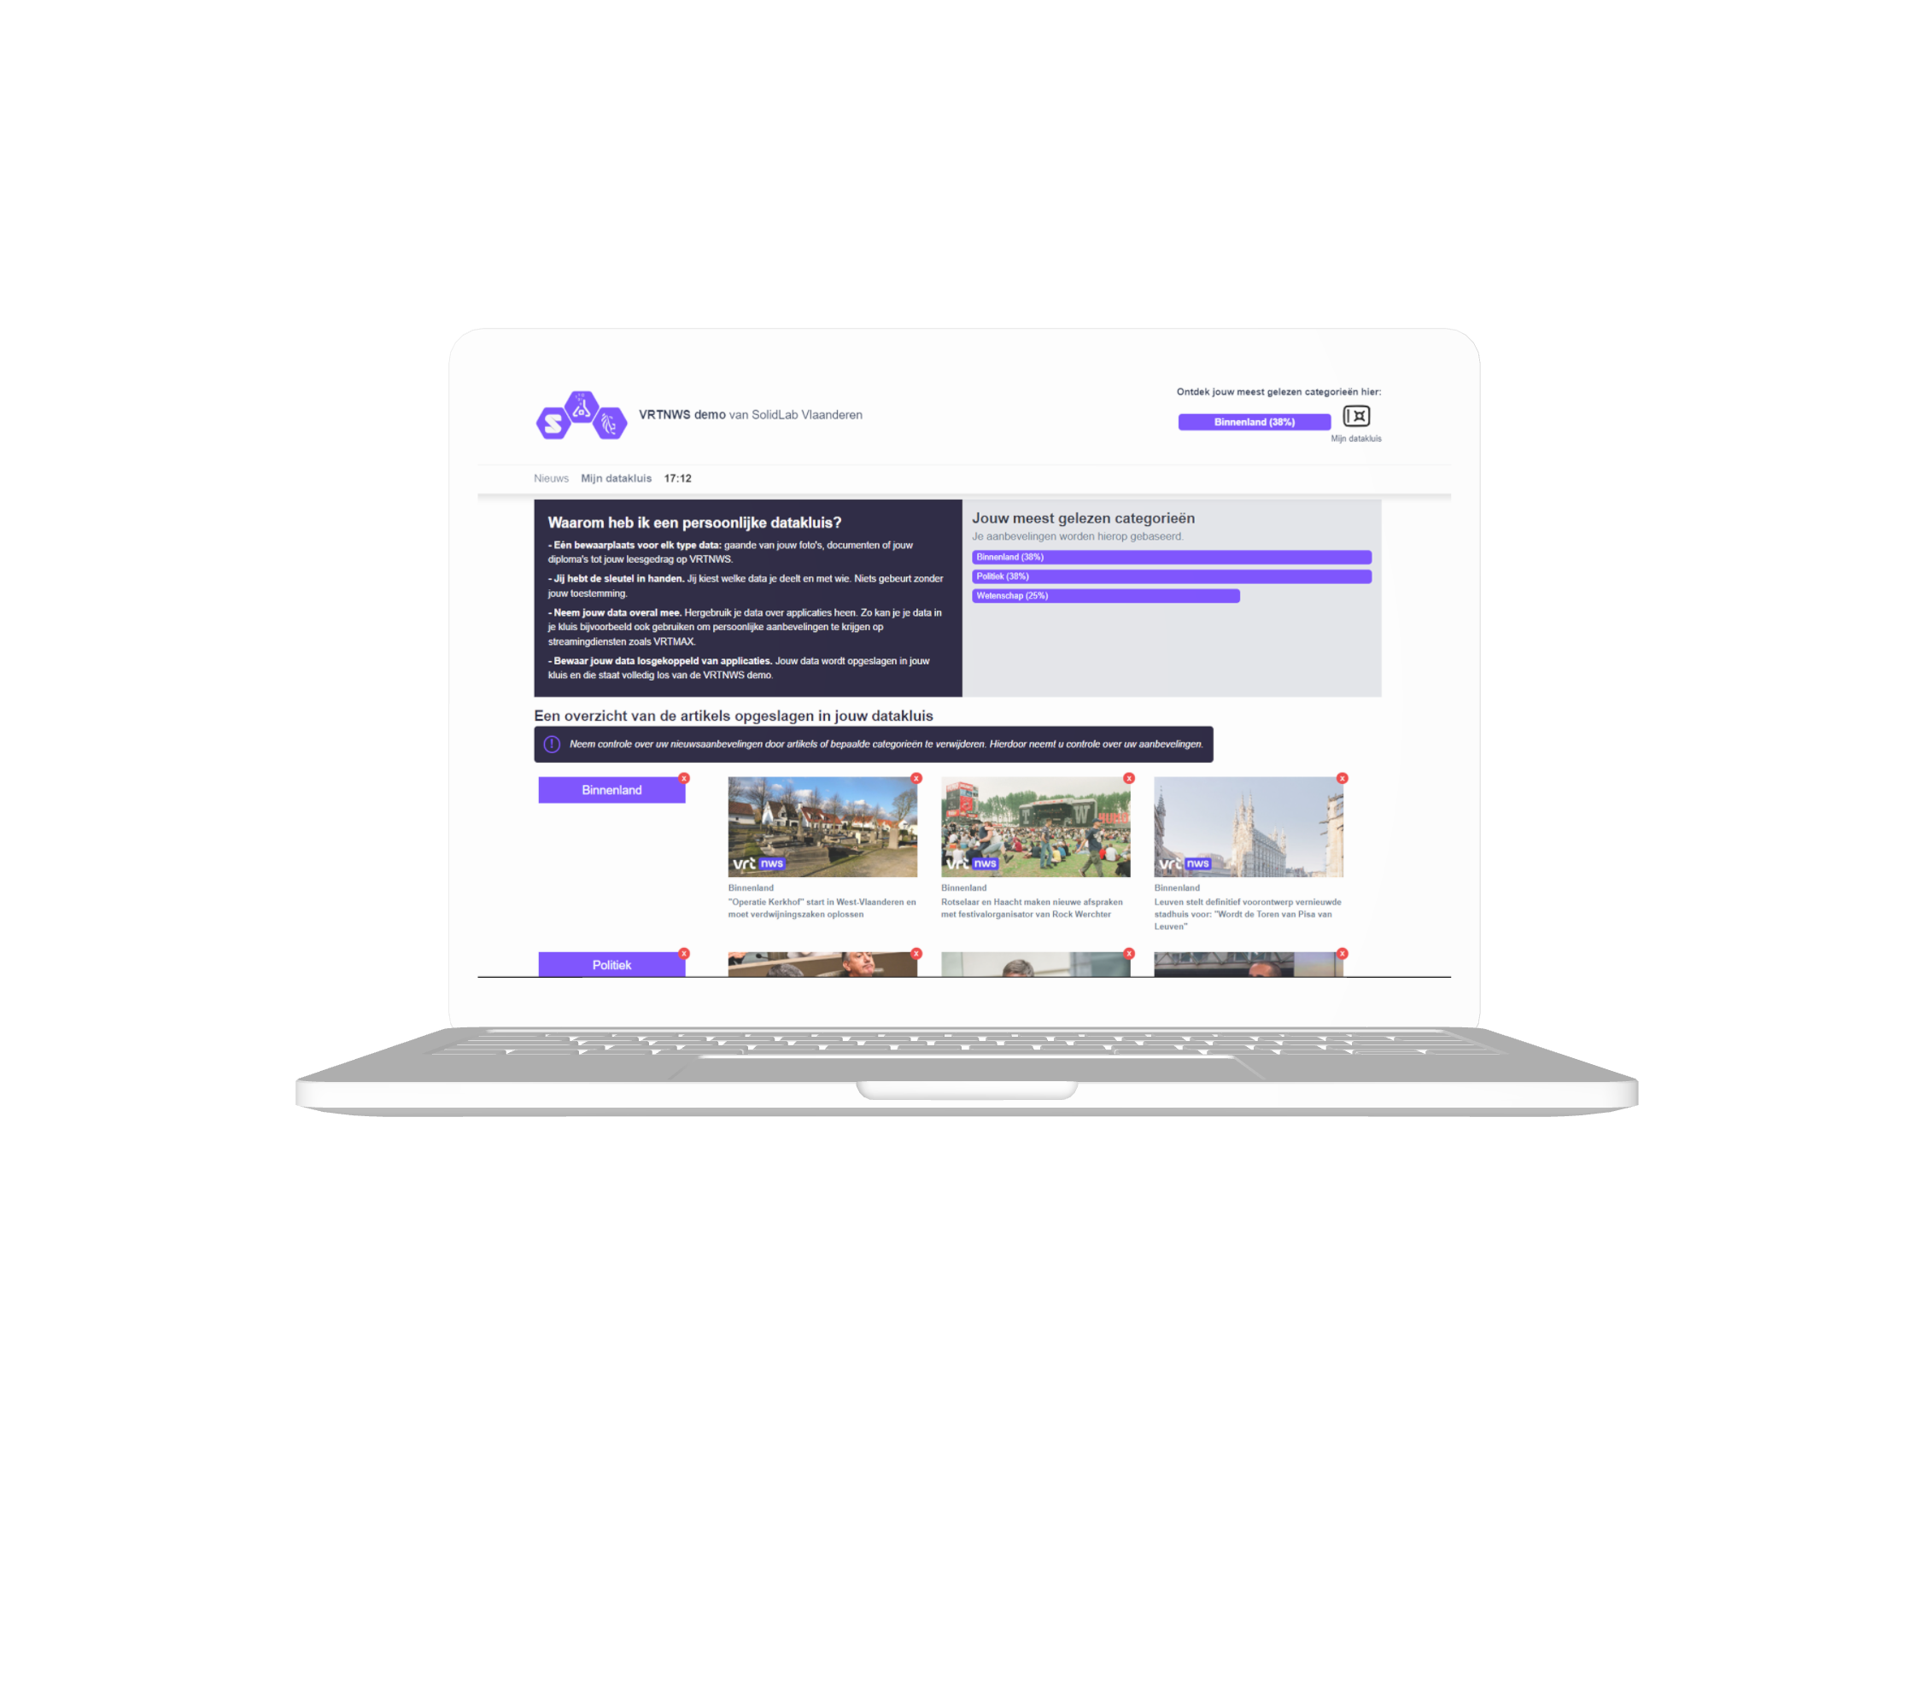
The effect of different levels of transparency and control over personal data processing was tested using 3 conditions.
Data vault transparency & control
Cookies
Data vault transparency
n=110
n=150
n=142
Notes:
To test the effect of a data vault on the users’ experience, we built three different versions of the news website, each version offered the same personalized news experience to users, using the same algorithm, but they differed in the way of how the user's personal data was being processed. Each version of the website was later tested by over a hundred participants, so we were able to measure the impact of the different designs.

Slide 7
1. Cookies
The reading behavior of the user is processed via cookies. Consequently, the user cannot view or manage the stored data.
n=150
n=142
Notes:
The first version of the website mimics the ‘as is’ situation and thus served the control condition. The users their reading behavior was processed using cookies. All the user's information the users got regarding their data processing was a cookie banner at the beginning of the experiment. Consequently, the users were unable to view or manage the data that was being stored.

Slide 8
2. Data vault transparency
The user can access his/her stored data through the data vault tab.
n=150
n=142
Notes:
The second condition made use a data vault integration to process the users their data. This means that the reading behavior of the participants was thus stored in their own data vault and users were able to access a tab on the website where they could see an overview of all the data that was being stored and an aggregated view of their most read categories to give them more insight into why certain categories were recommended to them. Further the tab also displayed some information on why they had personal data vault and how it works.

Slide 9
3. Data vault transparency & control
The user can access the stored data and delete articles through the data vault tab.
n=150
n=142
Notes:
The last condition is identical to the second but also allowed users to delete articles form their data vault, which give them more control over the personal recommendations they received.

Slide 10
The effect of different levels of transparency and control over personal data processing was tested using 3 conditions.
 | Cookies | Data vault transparency | Data vault transparency & control
Transparency: Insight into what data is processed for personalization. | No | Yes | Yes
Control: Ability to delete the data collected to affect personalization. | No | No | Yes
Notes:
So, to sum up: the first condition, using cookies, offered no insights into the data that was being processed, thus being the least transparent, and consequently also didn’t afford any control over users' data and the personalized recommendations. The second one offered more transparency through the data vault tab and the last one also allows users to take control over their data.

Slide 11
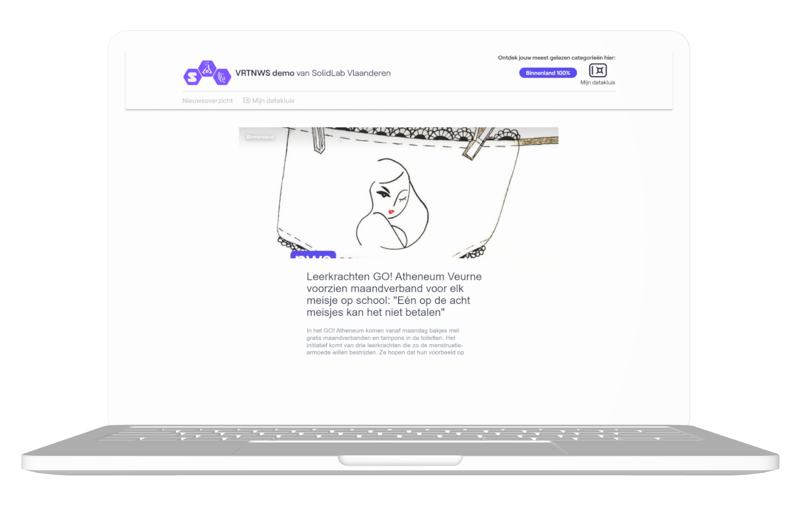
Experiment flow
10 min interaction with one of the three conditions
Survey of perceptions
n=150
n=142
Notes:
To measure the effects of a data vault integration we let participant interact with the one of the three conditions for 10min and surveyed them later about their perceptions.

Slide 12
Surveyed perceptions
Transparency
Control
Understanding
I have a clear view of how my personal data is processed.
I feel like I have control over my personal data.
I understand how my personal data is processed.
Trust
Usability
Intention to use
I trust the way my personal data is handled.
I found the website easy to use.
I plan to use this website in the future.
Notes:
We surveyed six relevant perceptions regarding the users their experience starting with 1) transparency, ...

Slide 13
The integration of a data vault has a significant positive impact on:
Transparency
Control
Understanding
I have a clear view of how my personal data is processed.
I feel like I have control over my personal data.
I understand how my personal data is processed.
Notes:
Our results show that the integration of a data vault had a significant effect on the users their perceived transparency, control and understanding about the processing of their personal data.

Slide 14
Transparency
I have a clear view of how my personal data is processed.
Data vault transparency and control
A data vault makes people feel that they have a clearer view of how their personal data is being handled.
Data vault transparency
Cookies
Notes:
Regarding transparency we found that user feel that they have a clearer view over how their personal data is being processed, compared to the use of cookies. We did not find a significant difference between the second and third conditions, which was as expected since users were offered the same overview in the data vault tab.

Slide 15
Understanding
I understand how my personal data is processed.
Data vault transparency and control
Data vault transparency
Greater transparency about data processing through a data vault also leads to a better understanding of it.
Cookies
Notes:
For understanding we found similar result: again, a significant difference between the integration of a datavault and cookies but no significant difference between the two datavault conditions.

Slide 16
Control
I feel like I have control over my personal data.
Remarkable: Transparency in particular influences perceived control. We see no additional effect by also effectively giving the user more control.
Data vault transparency and control
Data vault transparency
Cookies
Notes:
Lastly, we also found that the integration of a data vault had a significant impact on the users’ perception of control over their personal data. Remarkable here is that we didn’t not find a greater effect in the third condition, where people were given more control, compared to the second condition where people were just able to see what data was being stored. This suggest that just by giving people increased transparency, they also feel like they are more in control of their personal data.

Slide 17
The integration of a data vault had no significant impact on:
Trust
Usability
Intention to use
I trust the way my personal information is handled.
I found the website easy to use.
I plan to use this site in the future.
Cookies Data vault transparency Data vault transparency and control
Notes:
It’s also important to notice that we didn’t find any significant effect due to the integration of a data vault when it comes to trust, usability or intention to use the website.

Slide 18
“Ik vond de inlog procedure nogal chaotisch.”
“Was duidelijk, vlot navigeerbaar en duidelijke info over wat de artikels gaan.”
“Ik heb niets van Sport gezien.”
“Enkel een beetje saai qua lay-out en kleuren”
“Te veel nieuws in één keer.”
“Inzicht en controle op vergaarde privacygegevens moeten een prominentere plaats innemen op de website.”
Qualitative results
Feedback of the users on the news website
“Aanbod van nieuwsartikelen mocht iets ruimer zijn.”
“De meeste titels suggeren al een bepaalde visie op het nieuws die misschien niet overeenkomt met de visie van de lezer.”
“Vooral de afwezigheid van storende banners was een verademing.”
“Wie kan mijn interesses zien?”
“Datakluis media, datakluis overheid, datakluis bank, … Hoeveel nog?”
Notes:
In our qualitative analysis it also became apparent that the overall impression of the website was mostly influenced by the content of the articles, the attitude of people towards a recommender system for and the layout of the website, rather than the presence of the data vault.

Slide 19
Classification of the qualitative feedback
N(total) = 191 remarks
Lay-out
Recommender system
Only 7 of the 191 remarks refer to the data vault
Bugs
N=42
N=25
N=23
N=7
Notes:
As you can see

Slide 20
Experiment 2
How can we heighten the users’ intention to use Solid?
Intention to use
I plan to use this site in the future.
Notes:
Given these results, and the fact that we found no significant impact on the intention to use the system when a data vault was implemented, it triggered us for a second experiment in which we wanted to dive a bit deeper into the motivation of people for adoption a data vault.

Slide 21
Technology Acceptance Model
Perceived Usefulness
Intention to use
Actual use
Perceived Ease of Use
Notes:
For this we started from the Technology Acceptance Model, in which Perceived usefulness and perceived ease of use are identified as the two main factors influencing users’ intention to use a system. I our experiment we aimed at heighting the perceived usefulness of data vault, through highlighting different aspects of a data vault.

Slide 22
3 different arguments aiming to heighten the perceived usefulness of Solid
Enhanced personalization
Enhanced control
Single Sign-On
Notes:
We thus set up an experiment in which we asked users to find an article on a news website but in order to access the newswebsite they first had to create a data vault. For this registration screen we created three different version, each highlighting a different aspect of data vaults. The first one highlighted enhanced control, the second one enhanced personalization and the last one SSO.

Slide 23
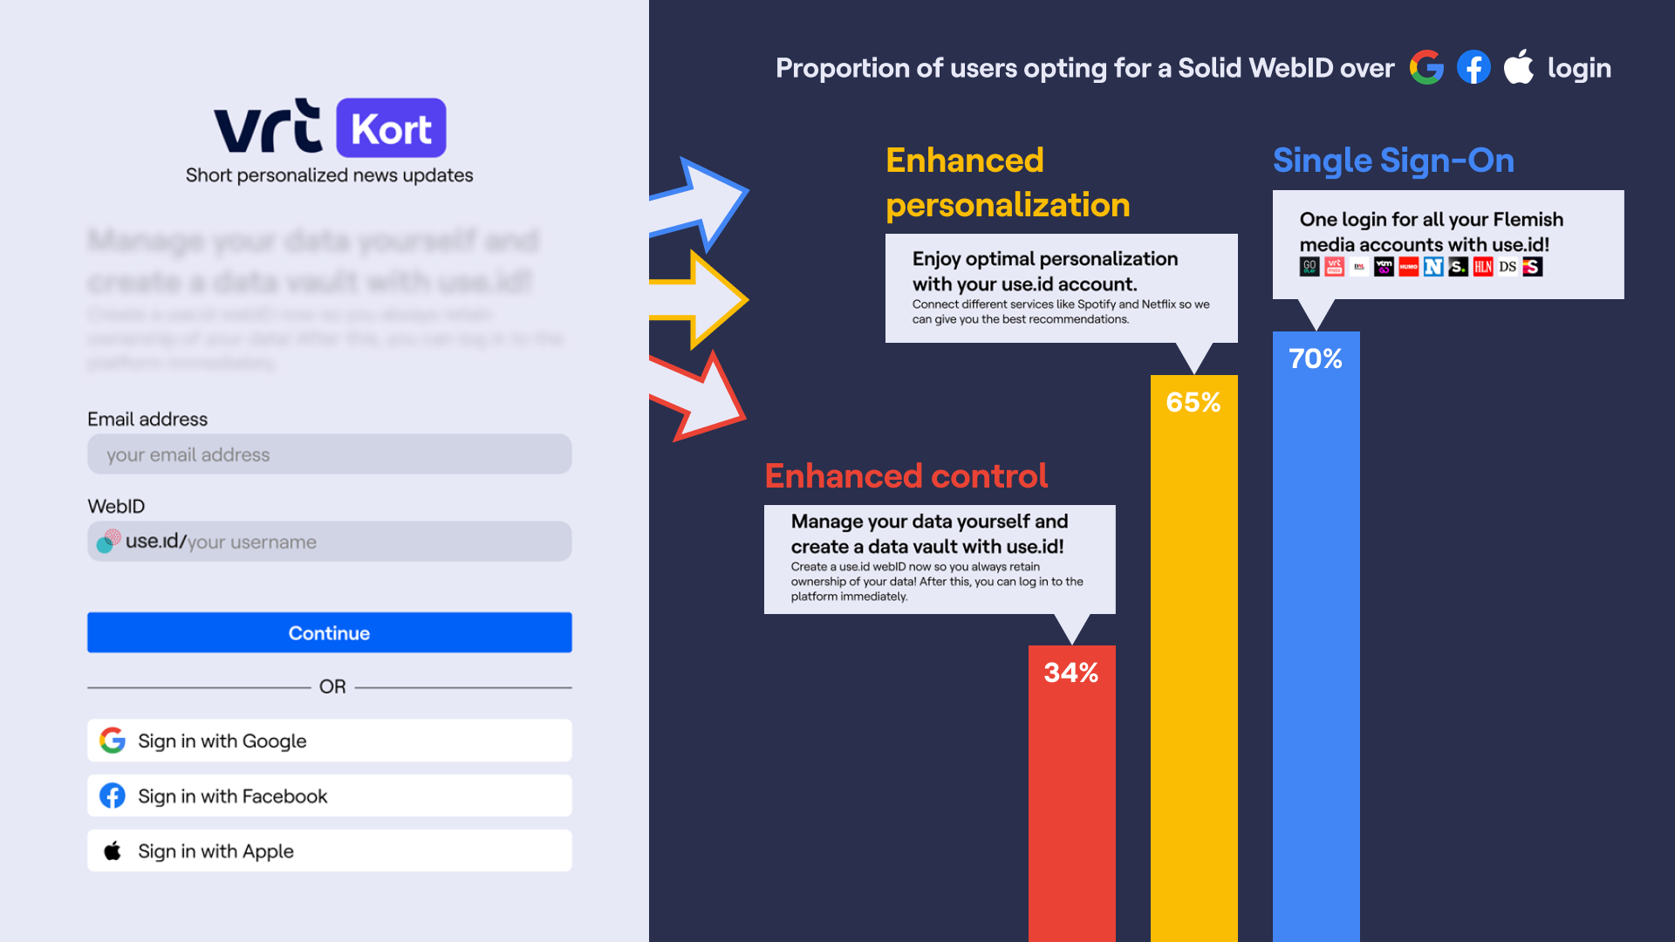
Proportion of users opting for Solid over login
70%
65%
34%
Notes:
We then compared the proportion of users that chose to create a datavault over the different conditions and found that significantly more people chose for a data vault when we emphasized benefits such as enhanced personalization or SSO over highlighting enhanced control over personal data.

Slide 24
Conclusion
Solid is a promising approach to heightening users’ perceptions of:
Transparency
Control
Understanding
But In order to enhance users’ intention to use Solid, it appears more effective to emphasize the benefits of Solid, such as improved personalization services, or position Solid as a Single Sign-On (SSO) solution, rather than placing the emphasis on enhanced control over personal data.
Notes:
We thus can conclude that solid is a promising approach to heighten users' perception of transparency control and understanding, but to heighten users' intention to use data vault it’s important to carefully consider which benefits are emphasized in the interface.

Slide 25
Question or remarks?
August.Bourgeus@vub.be

Slide 26
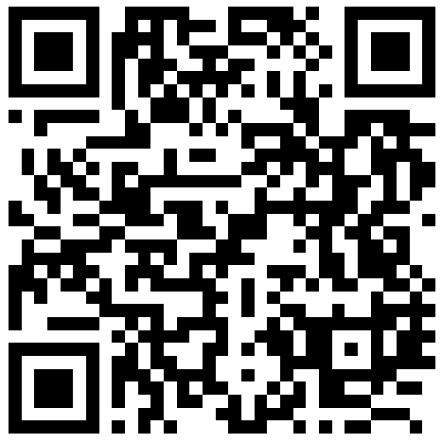
What do you think?
How important is it for users to understand the underlying technology (e.g., Solid) in the applications they use?
Very Important: Understanding strengthens trust and enhances engagement with the application.
Moderately Important: Basic knowledge is sufficient for most users, more information can be overwhelming.
Not Very Important: Ease of use and functionality are more crucial for the user experience.
1
Go to wooclap.com
Enter the event code IMECSOLID in the top banner
2
Disagree

