Slide 1
How to align business & governance in Solid ecosystems?
Maarten de Mildt & Sander Van Damme

Slide 2
“Most business ecosystems fail”
“And are not sustainable in the long run”
Source: https://www.bcg.com/publications/2020/why-do-most-business-ecosystems-fail

Slide 3
“Wrong governance choices are the number one reason they fail”
…So governance and business choices impact one another
Source: https://www.bcg.com/publications/2020/why-do-most-business-ecosystems-fail

Slide 4
How to align governance and business?
…and how we are trying to answer this question

Slide 5
Let’s circle back: “Most business ecosystems fail”
…what are business ecosystems,
and what do they have to do with Solid and data ecosystems?

Slide 6
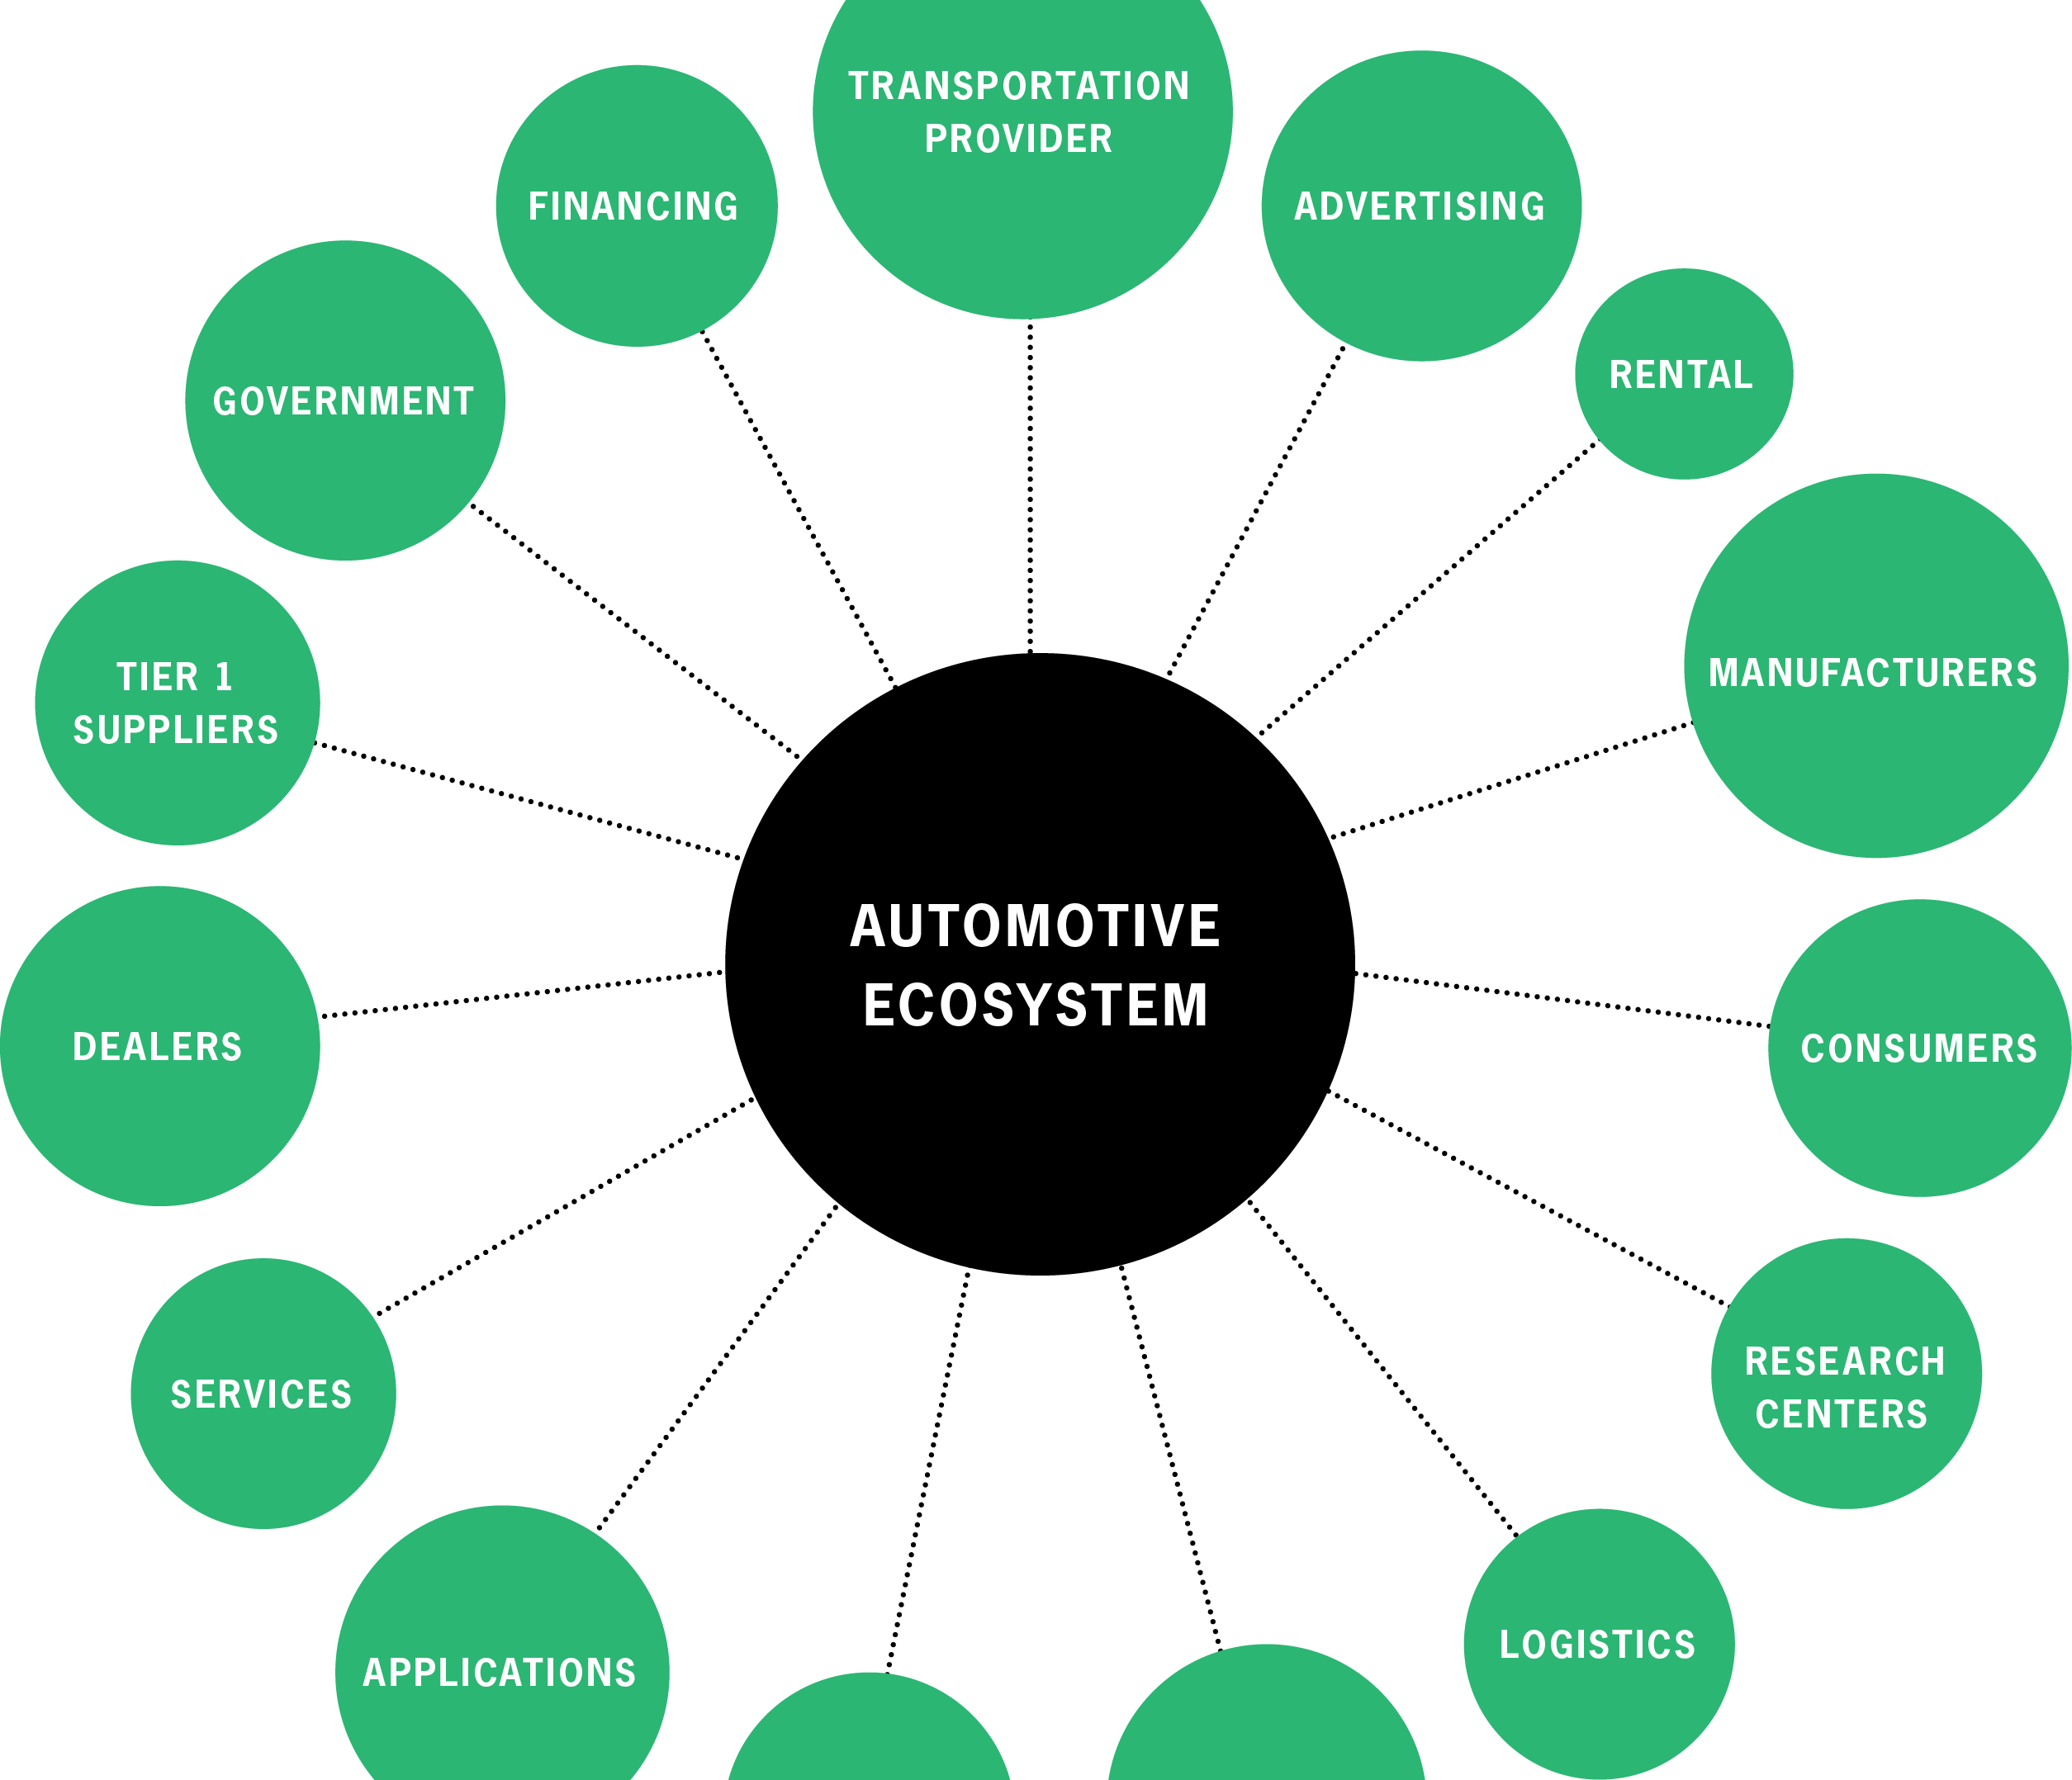
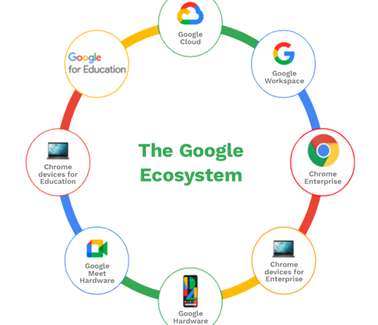
What are Business ecosystems?

Slide 7
What does this have to do with data ecosystems?
Data ecosystems inherit business ecosystem characteristics…
Technical and organizational systems
Multiple autonomous actors coopeting
Self-organizing
…and add some data specific ones
Data is a key, cyclical resource
Purpose of sharing data

Slide 8
Next up: “Wrong governance choices are the number one reason they fail”
…So what is ecosystem governance?

Slide 9
What is ecosystem governance?
?
Hierarchical control
Indirect control

Slide 10
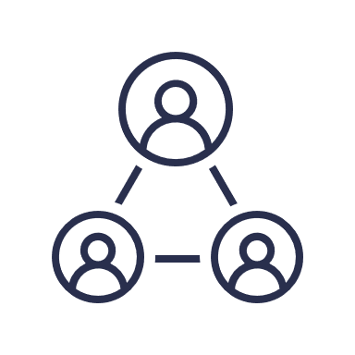
Ecosystem governance is a more complex story…
Growth and sustainability
aligning with architecture
dividing decision power
Diversity & flexibility
creating orchestration mechanisms
Control
creating motivation
Quality

Slide 11
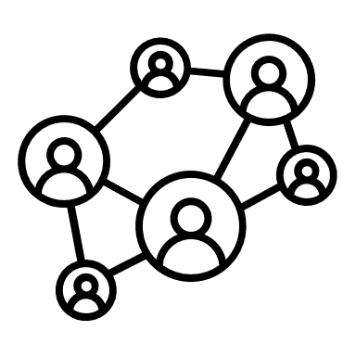
With multiple perspectives…
…and influences other platforms’ governance and business models
Platform governance model
Network governance
…interacts with other platforms through governance rules, like quality standards…
Platform business model

Slide 12
Given this complexity, is it possible to align governance and business?
…spoiler alert, we don’t know (yet)

Slide 13
We need to ask the right questions
…is there even such a thing as the right answer?

Slide 14
What are data ecosystem governance and business models?
Platform governance model
Data ecosystem governance models
Platform business model
Data ecosystem business models

Slide 15
Governance models
data cooperative
data commons
data collaborative
data trust
personal data sovereignty
data union
board
rulebook
architecture

Slide 16
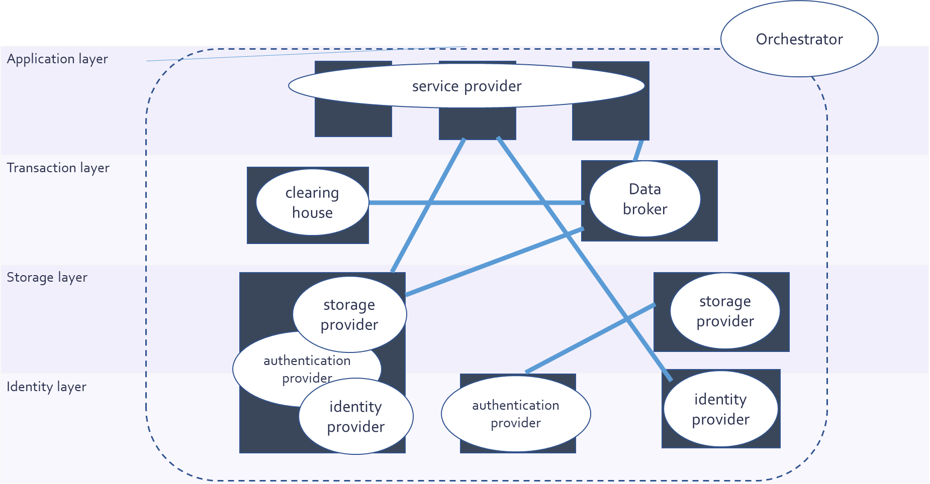
Business models

Slide 17
Why does this alignment matter?
Platform business model
Platform governance model
Network governance
And how to measure its success?
Notes:
Mention one example of business wise market share is a success criteria, but this leads to monopolies which defies the success criteria of diverse ecosystems from governance perspective

Slide 18
“Successful ecosystems acquire market share”
The main goal behind is continuous growth
Prevent catering towards one partner, customer or market
Does this mean the ecosystem initiator has market power?
Winner takes all scenario for ecosystem initiator?
Does this lead to new monopolies?

Slide 19
“Successful ecosystems create more value than individuals”
The main goal here is sustainable value creation
While maintaining fairness within the ecosystem
Sustainable value means value for each ecosystem actor
Do actors expect individual rewards and return on investments?
Is there a misalignment in value expectations?

Slide 20
“Successful ecosystems distribute power fairly”
Open
Quality
Power distribution
Interconnectedness
Interdependencies
Power distribution
Do parties that control such decisions have more power?
Does this lead to arbitrary markets?

Slide 21
How are we making sense of it all?
We started with a systematic scan of literature

Slide 22
Going back to the origin of data ecosystems
Platform theory
Ecosystem theory
(technical) component of ecosystem
cooperation & coexistence
network effects
Data
Ecosystems
sustainable in changing environment
orchestrated collaboration
Beyond firm-centric relationships
Notes:
Technical component also used in the context of “part of the ecosystem”

Slide 23
Different background, different goals?
Platform theory
(technical) component of ecosystem
e.g. set boundaries of ecosystem
network effects
e.g. accumulate market share
orchestrated collaboration
e.g. stakeholders inscribe platform rules
Notes:
Show the “misalignment” of goals

Slide 24
Different background, different goals?
Ecosystem theory
e.g. create value networks
cooperation & coexistence
e.g. collective surivival
sustainable in changing environment
e.g. establish interlinked vision
Beyond firm-centric relationships
Notes:
Technical component also used in the context of “part of the ecosystem”

Slide 25
Different background to Data Ecosystems
What do these different goals mean for data ecosystems?
(technical) component of ecosystem
cooperation & coexistence
network effects
Data
Ecosystems
sustainable in changing environment
orchestrated collaboration
Beyond firm-centric relationships
Notes:
Show the “misalignment” of goals

Slide 26
Figure out which use cases are considered
Technology-centered
Sector-oriented
Open Data
Open Source Software
Tourism
Medical
Open Government data platforms
Recommender systems
Cultural
Research
Spatial open data ecosystems
Blockchain implementations
Agriculture
Energy
Personal data
management platforms
Transport
Smart city open data
Automotive
Open data initiatives
IoT
Regulatory Tech
Financial
Food industry

Slide 27
Does aligning governance and business in data ecosystems require new goals?
We’ll leave you with the concluding question:

Slide 28
What do you think?
Agree
Fair governance mechanisms hinder innovation and growth.
1
Go to wooclap.com
Enter the event code IMECSOLID in the top banner
2
Disagree

