Slide 1
Insights & take-aways from the SolidLab project
2nd Solid Symposium
2-3 May 2024
Leuven, Belgium

Slide 2




Taxonomy PDS
-> explaining what we want to learn from this and where we want to go
Karim Dahdah
VRT
Dorien Bauwens
athumi
Esther De Loof
imec
Ana Pop Stefanija
VUB

Slide 3
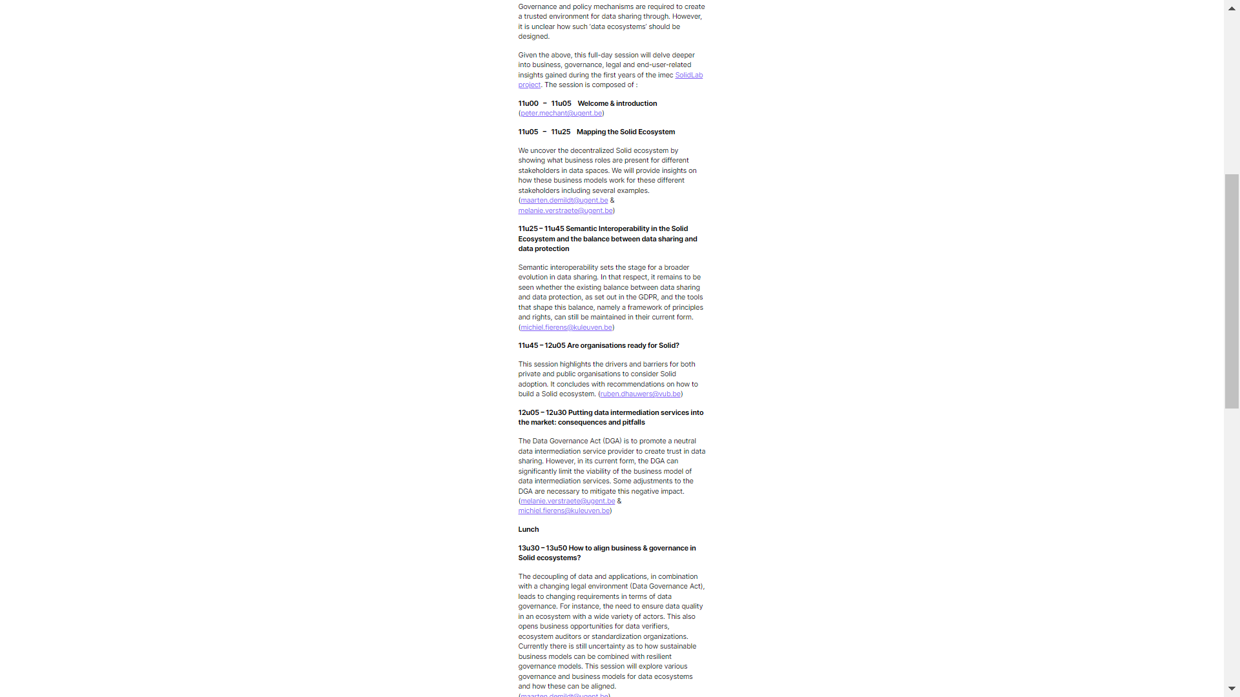
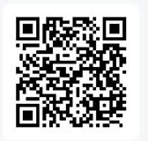
Taxonomy PDS
w
-> explaining what we want to learn from this and where we want to go
wooclap.com
event code = IMECSOLID

Slide 4
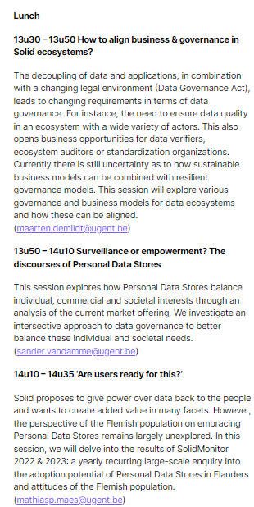
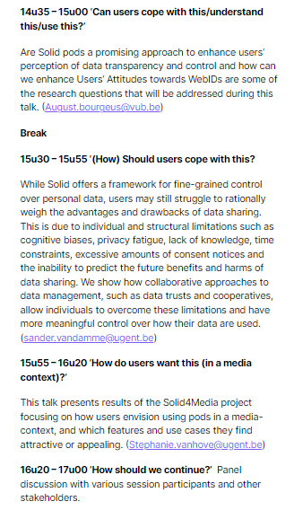
Taxonomy PDS
w
-> explaining what we want to learn from this and where we want to go
wooclap.com
event code = IMECSOLID

Slide 5
Taxonomy PDS
Mapping the Solid Ecosystem
(maarten.demildt@ugent.be & melanie.verstraete@ugent.be)
Do you think Solid pods can become the next Google Drive? Definitely/No way!
w
-> explaining what we want to learn from this and where we want to go

Slide 6
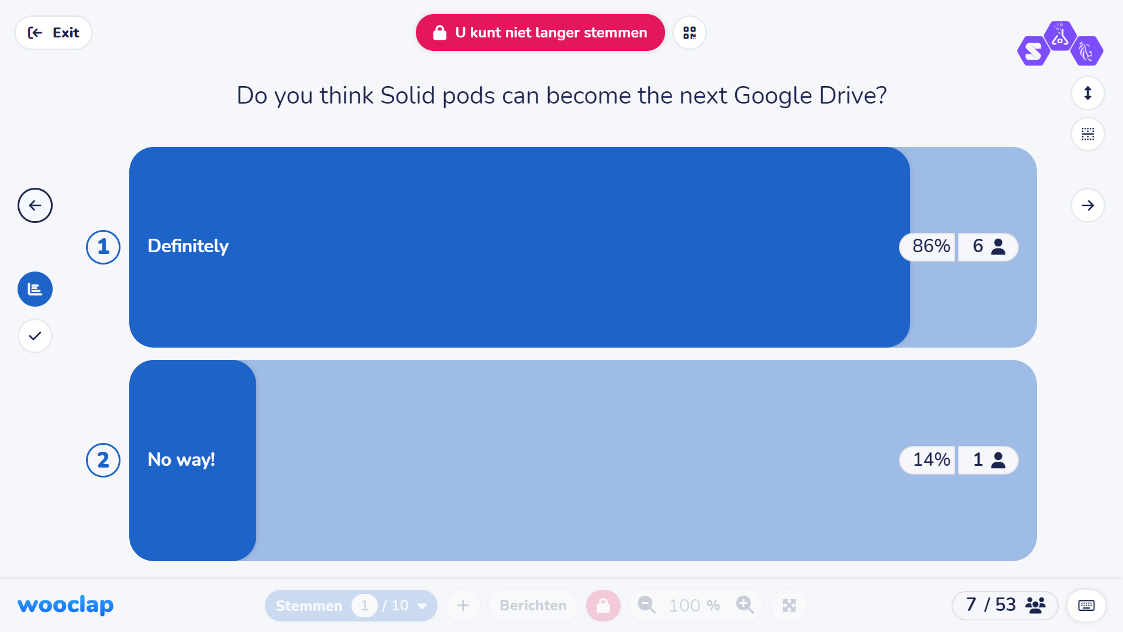
Taxonomy PDS
-> explaining what we want to learn from this and where we want to go

Slide 7
Taxonomy PDS
Semantic Interoperability in the Solid Ecosystem and the balance between data sharing and data protection
(michiel.fierens@kuleuven.be)
How can we find a balance between the individual and the collective when processing data in a (semantically interoperable) ecosystem?
      - by agreeing/enforcing collective responsibilities
      - by taking into account the context when considering individual and collective interests and the balance between them
      - by identifying collective interests and damage
4. 11u45 – 12u05 Are organisations ready for Solid?
(ruben.dhauwers@vub.be)
Are private data providers willing to grant complete data control to data subjects?
• Yes, they will allow data subjects to share all data
• It depends on the type of data and with which companies
• No, they will not allow data subjects to share any data
5. 12u05 – 12u30 Putting data intermediation services into the market: consequences and pitfalls
(melanie.verstraete@ugent.be & michiel.fierens@kuleuven.be)
Do you feel that the provision of a data intermediation service is economically viable?
- Yes, under current legislation (in particular DGA)
- Yes, but only if current legislation (in particular DGA) is further clarified and adapted
- No
Lunch
6. 13u30 – 13u50 How to align business & governance in Solid ecosystems?
(maarten.demildt@ugent.be & sander.vandamme@ugent.be)
Fair governance mechanisms hinder innovation & growth. Agree/not agree
7. 13u50 – 14u10 Surveillance or empowerment? The discourses of Personal Data Stores
(sander.vandamme@ugent.be)
The monetization of personal data through PDS undermines the fundamental right to privacy. Yes/No
8. 14u10 – 14u35 ‘Are users ready for this?’
(mathiasp.maes@ugent.be)
Solid should be marketed to end-users as a ‘privacy solution’ giving back control to users.
- Agreed. I see this as the most important feature for end-users
- We should put more emphasis on Solid bringing data from various sources together to create more innovative applications
- We should put more emphasis on Solid as a secure storage and authentication architecture
9. 14u35 – 15u00 ‘Can users cope with this/understand this/use this?’
(August.bourgeus@vub.be)
How important is it for users to understand the underlying technology (e.g., Solid) in the applications they use?
- Very Important: Understanding strengthens trust and enhances engagement with the application.
- Moderately Important: Basic knowledge is sufficient for most users, more information can be overwhelming.
- Not Very Important: Ease of use and functionality are more crucial for the user experience.
Break
10. 15u30 – 15u55 ‘(How) Should users cope with this?
(sander.vandamme@ugent.be)
Data cooperatives are essential to restore the power balance between individuals and big tech companies. Yes/No
11. 15u55 – 16u20 ‘How do users want this (in a media context)?’
(Stephanie.vanhove@ugent.be)
The low acceptance rate of personal data vaults for media services is due to a fundamental lack of added value. Agree/not agree
w
-> explaining what we want to learn from this and where we want to go

Slide 8
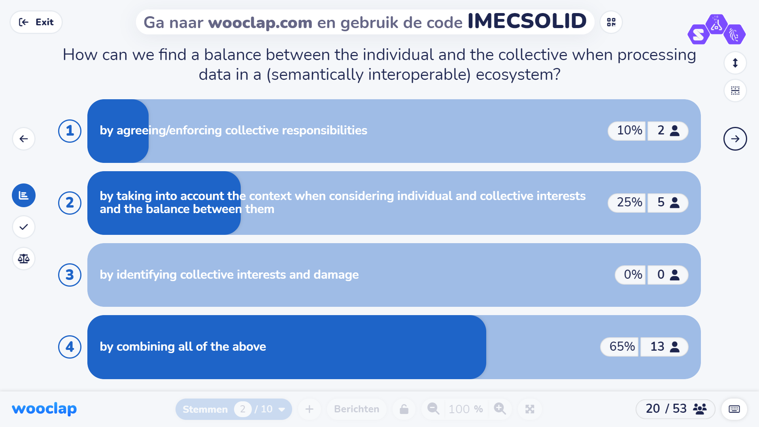
Taxonomy PDS
-> explaining what we want to learn from this and where we want to go

Slide 9
Taxonomy PDS
Are organisations ready for Solid?
(ruben.dhauwers@vub.be)
Are private data providers willing to grant complete data control to data subjects?
    Yes, they will allow data subjects to share all data
    It depends on the type of data and with which companies
    No, they will not allow data subjects to share any data
5. 12u05 – 12u30 Putting data intermediation services into the market: consequences and pitfalls
(melanie.verstraete@ugent.be & michiel.fierens@kuleuven.be)
Do you feel that the provision of a data intermediation service is economically viable?
- Yes, under current legislation (in particular DGA)
- Yes, but only if current legislation (in particular DGA) is further clarified and adapted
- No
Lunch
6. 13u30 – 13u50 How to align business & governance in Solid ecosystems?
(maarten.demildt@ugent.be & sander.vandamme@ugent.be)
Fair governance mechanisms hinder innovation & growth. Agree/not agree
7. 13u50 – 14u10 Surveillance or empowerment? The discourses of Personal Data Stores
(sander.vandamme@ugent.be)
The monetization of personal data through PDS undermines the fundamental right to privacy. Yes/No
8. 14u10 – 14u35 ‘Are users ready for this?’
(mathiasp.maes@ugent.be)
Solid should be marketed to end-users as a ‘privacy solution’ giving back control to users.
- Agreed. I see this as the most important feature for end-users
- We should put more emphasis on Solid bringing data from various sources together to create more innovative applications
- We should put more emphasis on Solid as a secure storage and authentication architecture
9. 14u35 – 15u00 ‘Can users cope with this/understand this/use this?’
(August.bourgeus@vub.be)
How important is it for users to understand the underlying technology (e.g., Solid) in the applications they use?
- Very Important: Understanding strengthens trust and enhances engagement with the application.
- Moderately Important: Basic knowledge is sufficient for most users, more information can be overwhelming.
- Not Very Important: Ease of use and functionality are more crucial for the user experience.
Break
10. 15u30 – 15u55 ‘(How) Should users cope with this?
(sander.vandamme@ugent.be)
Data cooperatives are essential to restore the power balance between individuals and big tech companies. Yes/No
11. 15u55 – 16u20 ‘How do users want this (in a media context)?’
(Stephanie.vanhove@ugent.be)
The low acceptance rate of personal data vaults for media services is due to a fundamental lack of added value. Agree/not agree
w
-> explaining what we want to learn from this and where we want to go

Slide 10
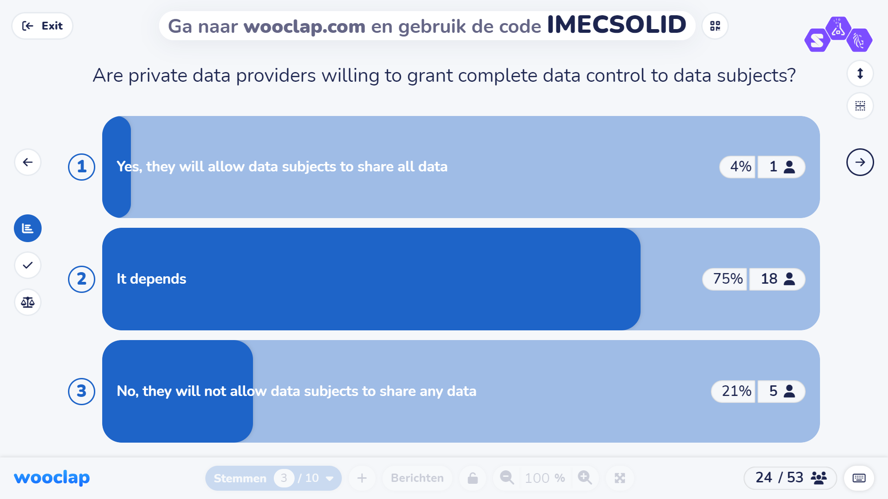
Taxonomy PDS
-> explaining what we want to learn from this and where we want to go

Slide 11
Taxonomy PDS
Putting data intermediation services into the market: consequences and pitfalls
(melanie.verstraete@ugent.be & michiel.fierens@kuleuven.be)
Do you feel that the provision of a data intermediation service is economically viable?
Yes, under current legislation (in particular DGA)
Yes, but only if current legislation (in particular DGA) is further clarified and adapted
No
Lunch
6. 13u30 – 13u50 How to align business & governance in Solid ecosystems?
(maarten.demildt@ugent.be & sander.vandamme@ugent.be)
Fair governance mechanisms hinder innovation & growth. Agree/not agree
7. 13u50 – 14u10 Surveillance or empowerment? The discourses of Personal Data Stores
(sander.vandamme@ugent.be)
The monetization of personal data through PDS undermines the fundamental right to privacy. Yes/No
8. 14u10 – 14u35 ‘Are users ready for this?’
(mathiasp.maes@ugent.be)
Solid should be marketed to end-users as a ‘privacy solution’ giving back control to users.
- Agreed. I see this as the most important feature for end-users
- We should put more emphasis on Solid bringing data from various sources together to create more innovative applications
- We should put more emphasis on Solid as a secure storage and authentication architecture
9. 14u35 – 15u00 ‘Can users cope with this/understand this/use this?’
(August.bourgeus@vub.be)
How important is it for users to understand the underlying technology (e.g., Solid) in the applications they use?
- Very Important: Understanding strengthens trust and enhances engagement with the application.
- Moderately Important: Basic knowledge is sufficient for most users, more information can be overwhelming.
- Not Very Important: Ease of use and functionality are more crucial for the user experience.
Break
10. 15u30 – 15u55 ‘(How) Should users cope with this?
(sander.vandamme@ugent.be)
Data cooperatives are essential to restore the power balance between individuals and big tech companies. Yes/No
11. 15u55 – 16u20 ‘How do users want this (in a media context)?’
(Stephanie.vanhove@ugent.be)
The low acceptance rate of personal data vaults for media services is due to a fundamental lack of added value. Agree/not agree
w
-> explaining what we want to learn from this and where we want to go

Slide 12
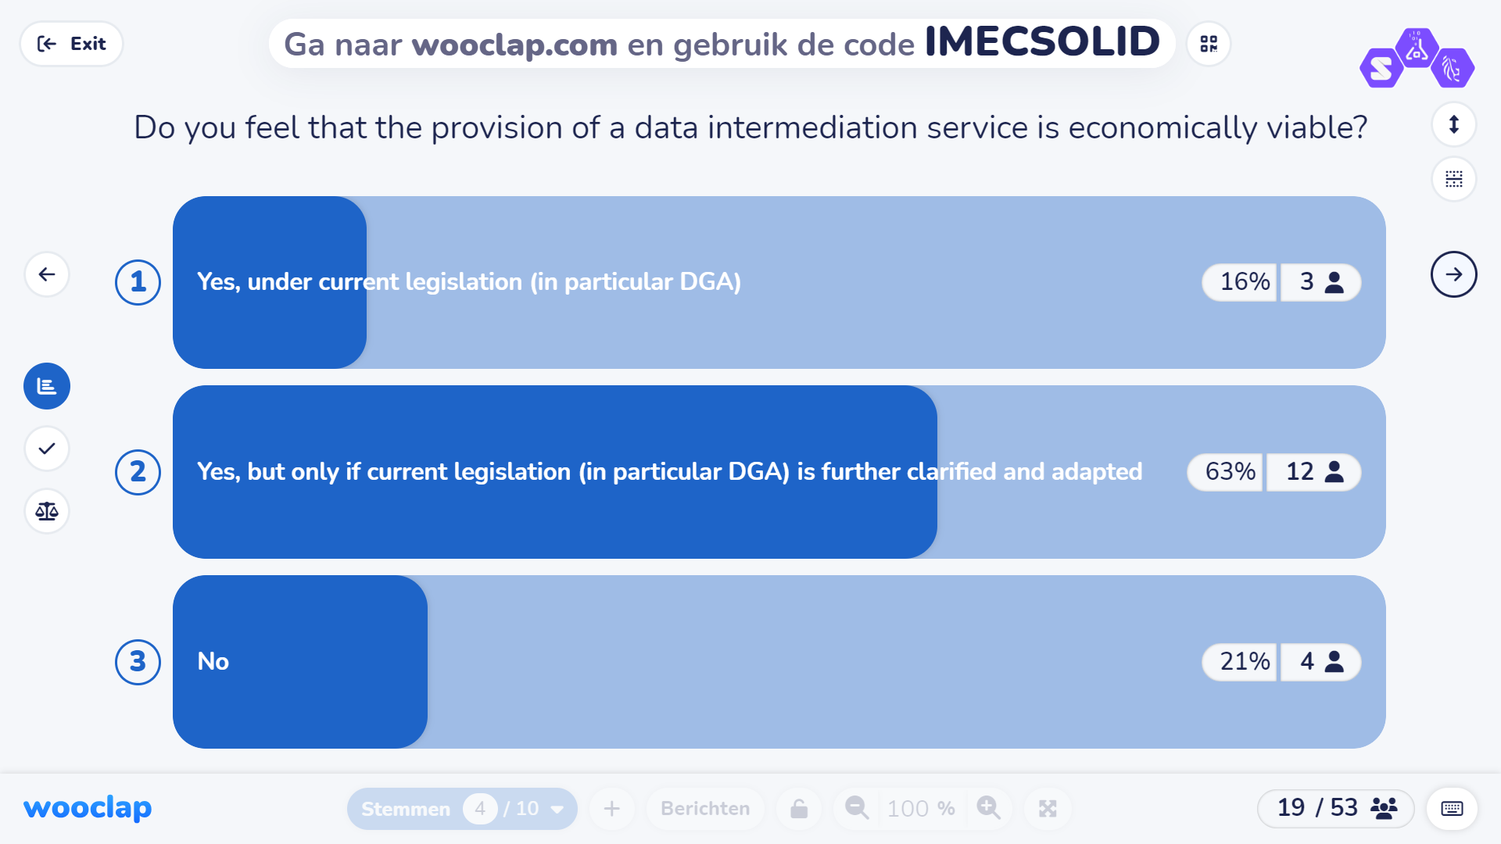
Taxonomy PDS
-> explaining what we want to learn from this and where we want to go

Slide 13
Taxonomy PDS
How to align business & governance in Solid ecosystems?
(maarten.demildt@ugent.be & sander.vandamme@ugent.be)
Fair governance mechanisms hinder innovation & growth. Agree/not agree
w
-> explaining what we want to learn from this and where we want to go

Slide 14
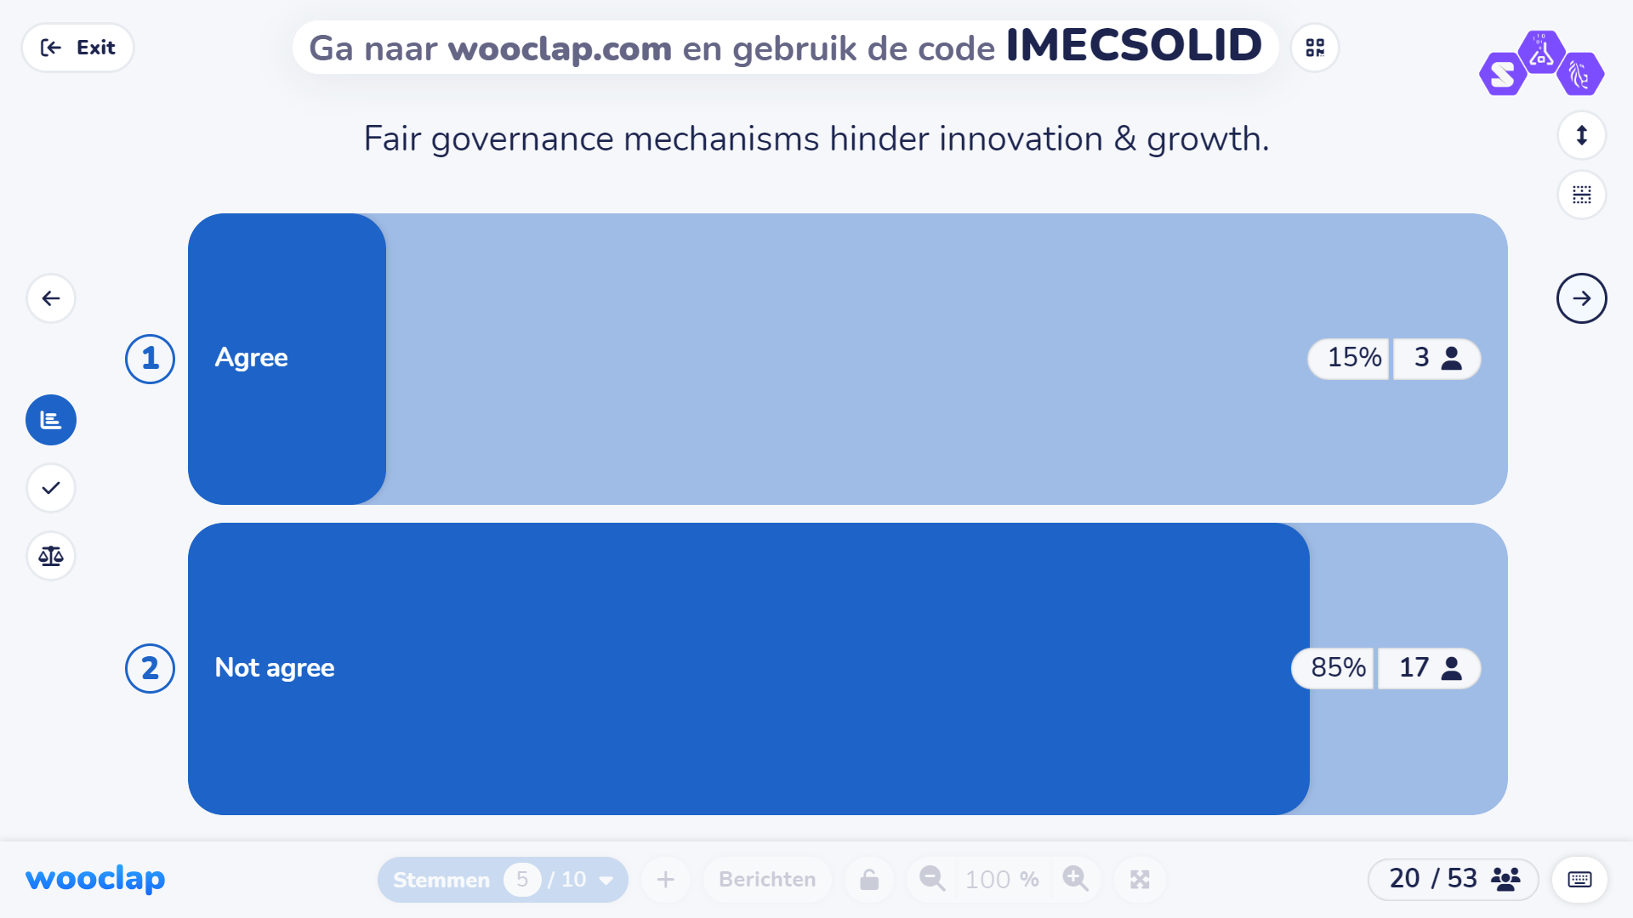
Taxonomy PDS
-> explaining what we want to learn from this and where we want to go

Slide 15
Taxonomy PDS
Surveillance or empowerment? The discourses of Personal Data Stores
(sander.vandamme@ugent.be)
The monetization of personal data through PDS undermines the fundamental right to privacy.
Yes/No
w
-> explaining what we want to learn from this and where we want to go

Slide 16
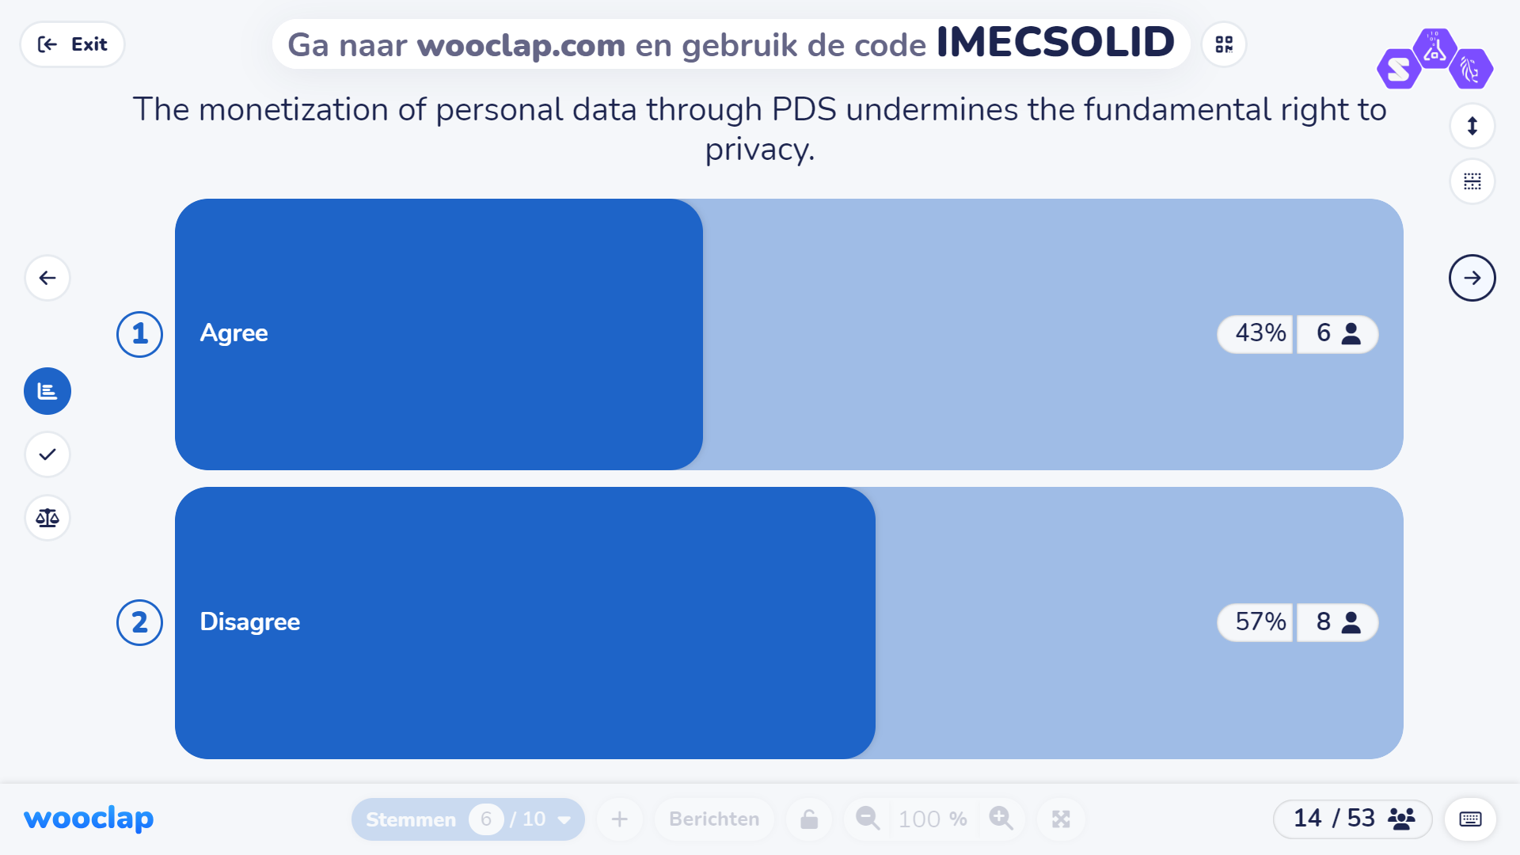
Taxonomy PDS
-> explaining what we want to learn from this and where we want to go

Slide 17
Taxonomy PDS
‘Are users ready for this?’
(mathiasp.maes@ugent.be)
Solid should be marketed to end-users as a ‘privacy solution’ giving back control to users.
  Agreed. I see this as the most important feature for end-users
  We should put more emphasis on Solid bringing data from various sources together to create more innovative applications.
  We should put more emphasis on Solid as a secure storage and authentication architecture
9. 14u35 – 15u00 ‘Can users cope with this/understand this/use this?’
(August.bourgeus@vub.be)
How important is it for users to understand the underlying technology (e.g., Solid) in the applications they use?
- Very Important: Understanding strengthens trust and enhances engagement with the application.
- Moderately Important: Basic knowledge is sufficient for most users, more information can be overwhelming.
- Not Very Important: Ease of use and functionality are more crucial for the user experience.
Break
10. 15u30 – 15u55 ‘(How) Should users cope with this?
(sander.vandamme@ugent.be)
Data cooperatives are essential to restore the power balance between individuals and big tech companies. Yes/No
11. 15u55 – 16u20 ‘How do users want this (in a media context)?’
(Stephanie.vanhove@ugent.be)
The low acceptance rate of personal data vaults for media services is due to a fundamental lack of added value. Agree/not agree
w
-> explaining what we want to learn from this and where we want to go

Slide 18
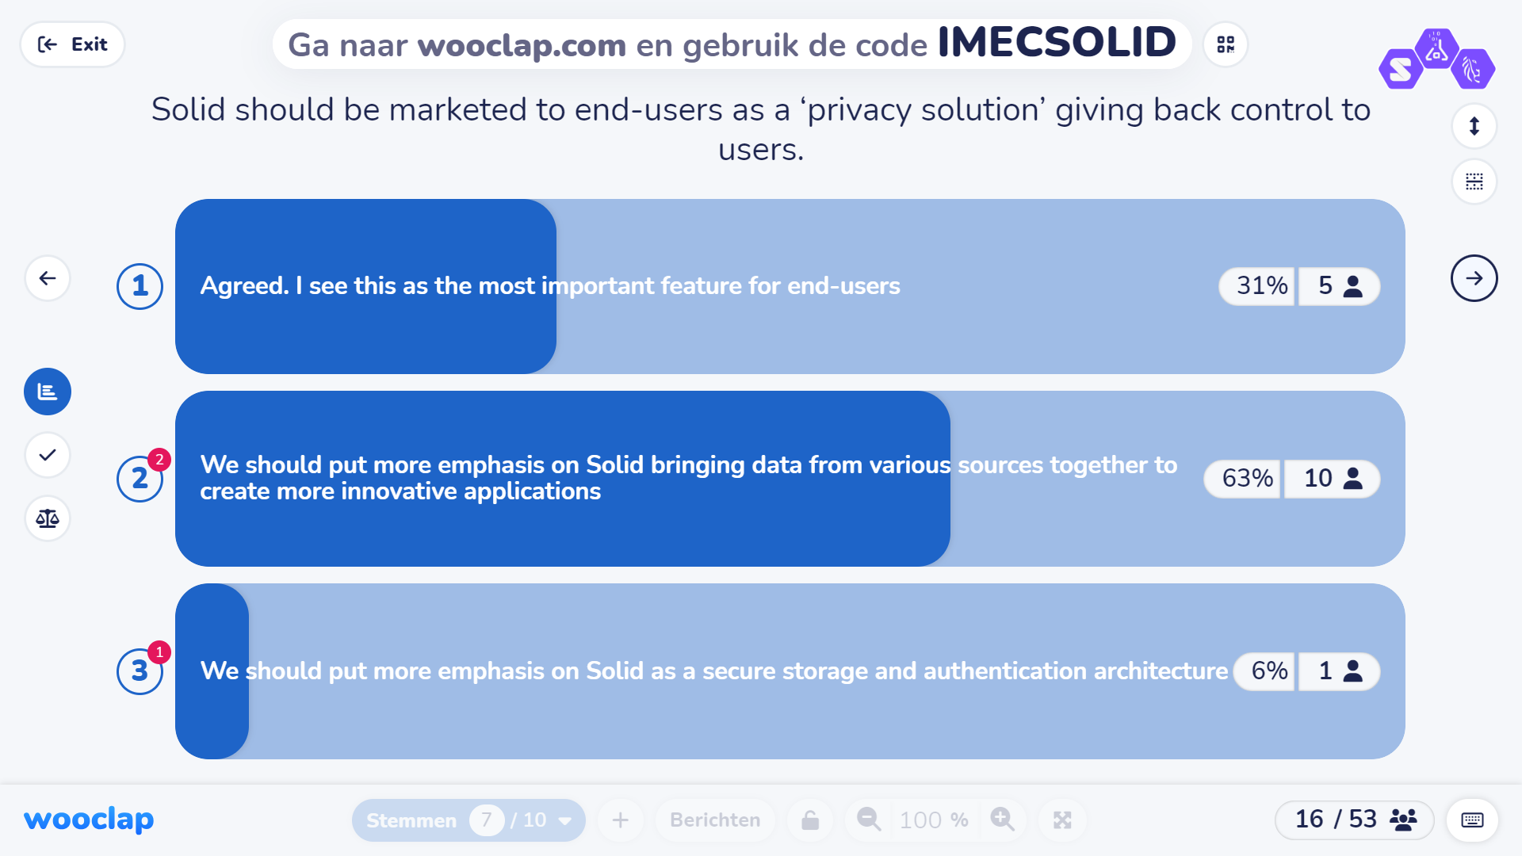
Taxonomy PDS
-> explaining what we want to learn from this and where we want to go

Slide 19
Taxonomy PDS
‘Can users cope with this/understand this/use this?’
(August.bourgeus@vub.be)
How important is it for users to understand the underlying technology (e.g., Solid) in the applications they use?
  Very Important: Understanding strengthens trust and enhances engagement with the application.
  Moderately Important: Basic knowledge is sufficient for most users, more information can be overwhelming.
  Not Very Important: Ease of use and functionality are more crucial for the user experience.
Break
10. 15u30 – 15u55 ‘(How) Should users cope with this?
(sander.vandamme@ugent.be)
Data cooperatives are essential to restore the power balance between individuals and big tech companies. Yes/No
11. 15u55 – 16u20 ‘How do users want this (in a media context)?’
(Stephanie.vanhove@ugent.be)
The low acceptance rate of personal data vaults for media services is due to a fundamental lack of added value. Agree/not agree
w
-> explaining what we want to learn from this and where we want to go

Slide 20
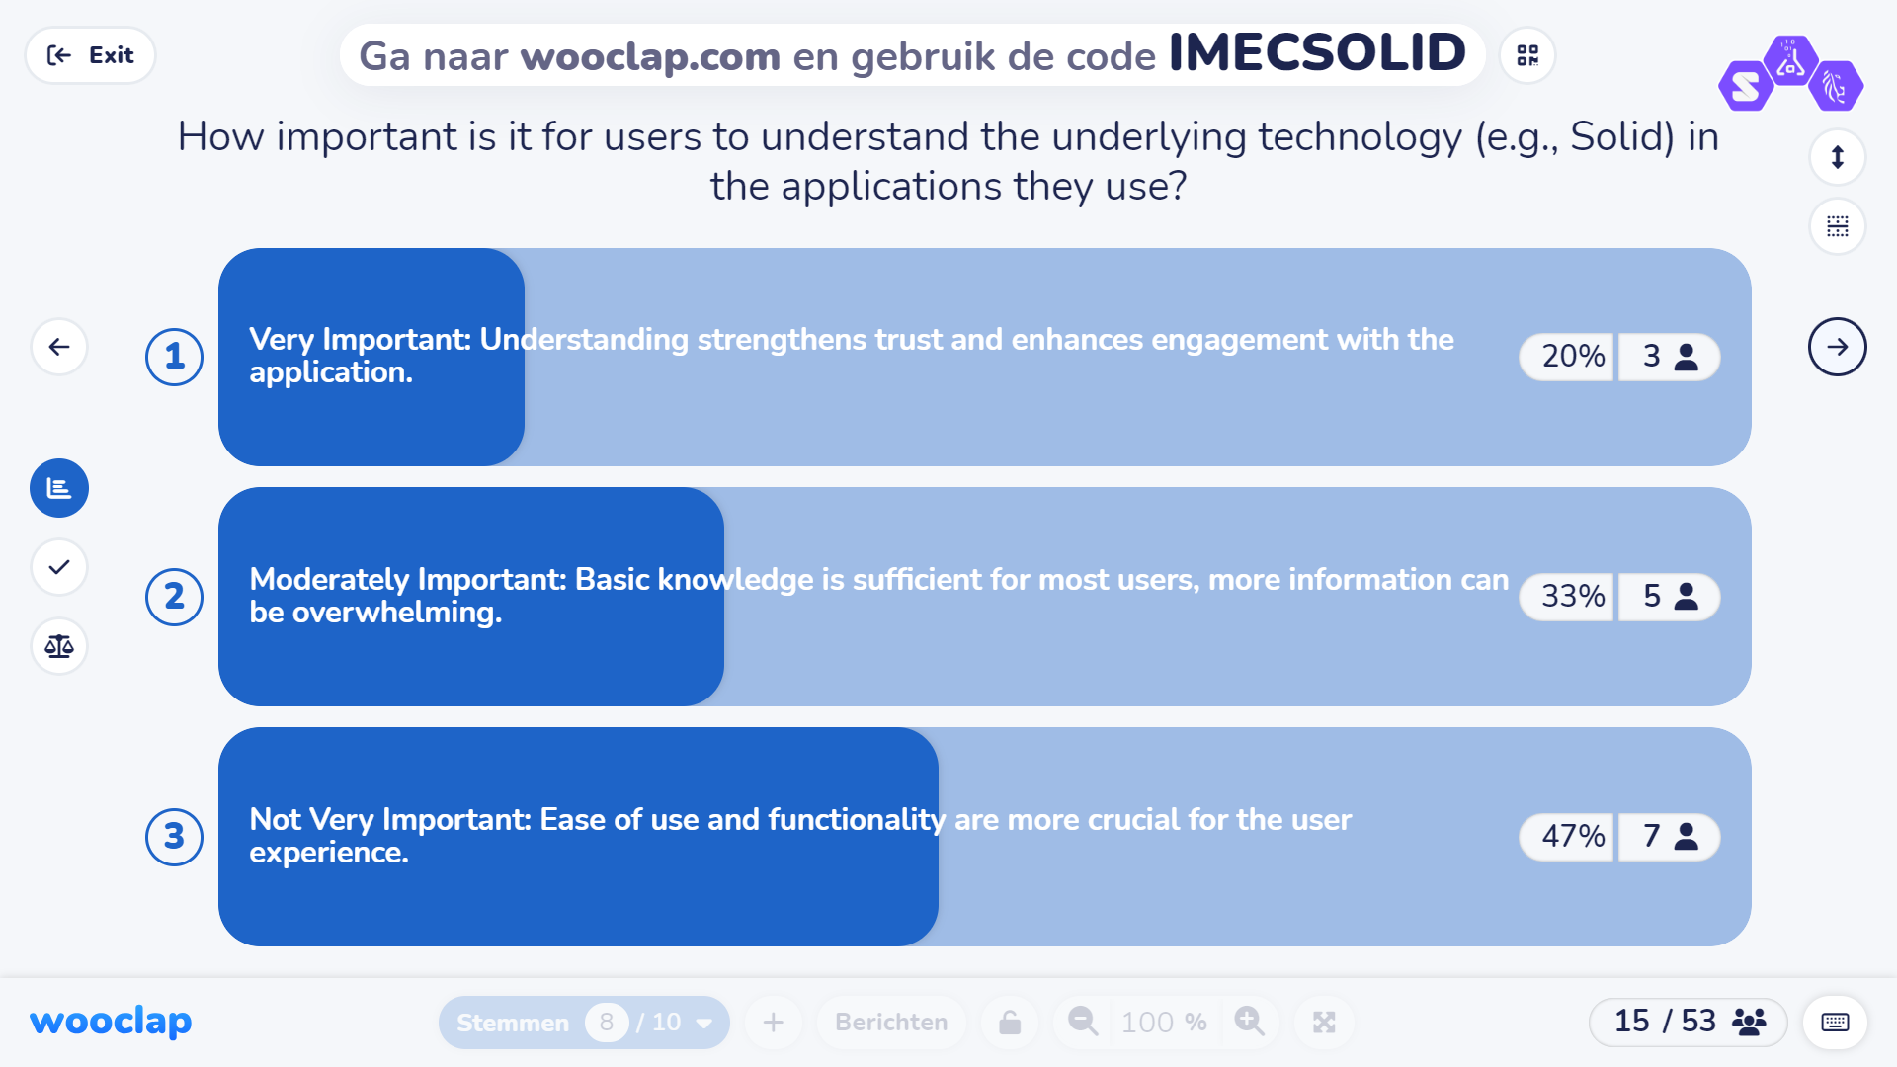
Taxonomy PDS
-> explaining what we want to learn from this and where we want to go

Slide 21
Taxonomy PDS
‘(How) Should users cope with this?
(sander.vandamme@ugent.be)
Data cooperatives are essential to restore the power balance between individuals and big tech companies.
Yes/No
w
-> explaining what we want to learn from this and where we want to go

Slide 22
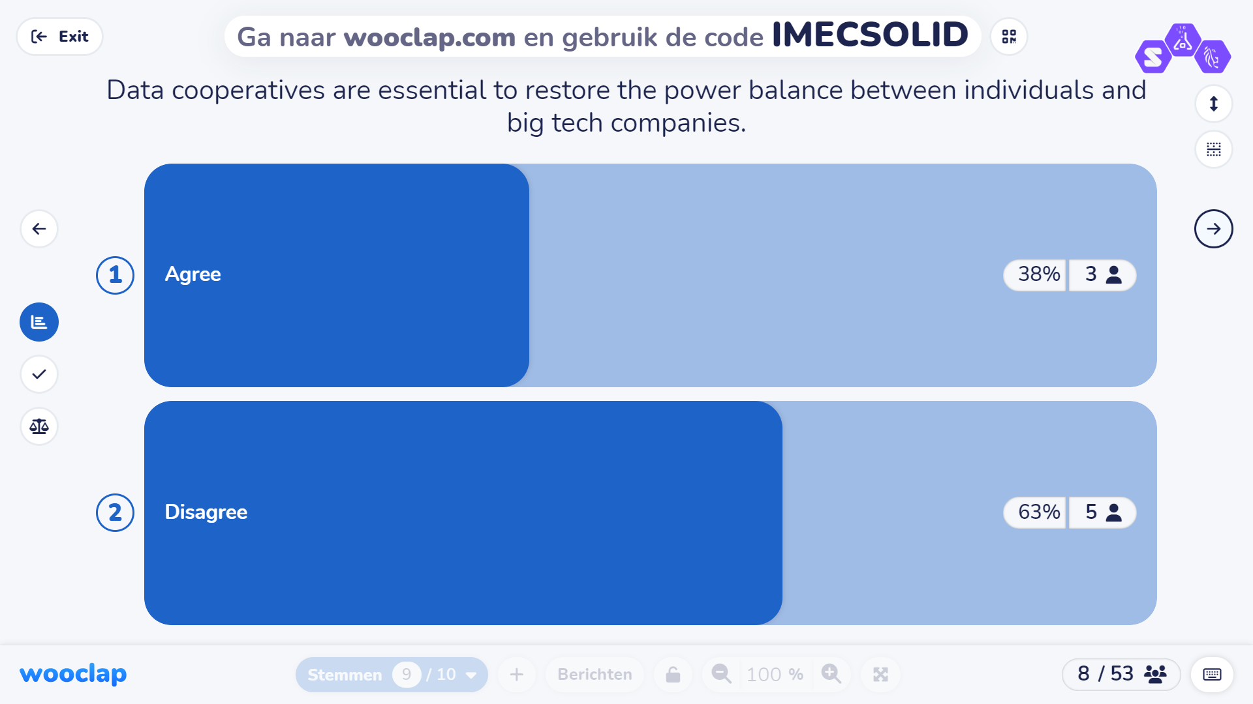
Taxonomy PDS
-> explaining what we want to learn from this and where we want to go

Slide 23
Taxonomy PDS
‘How do users want this (in a media context)?’
(Stephanie.vanhove@ugent.be)
The low acceptance rate of personal data vaults for media services is due to a fundamental lack of added value. Agree/not agree
w
-> explaining what we want to learn from this and where we want to go

Slide 24
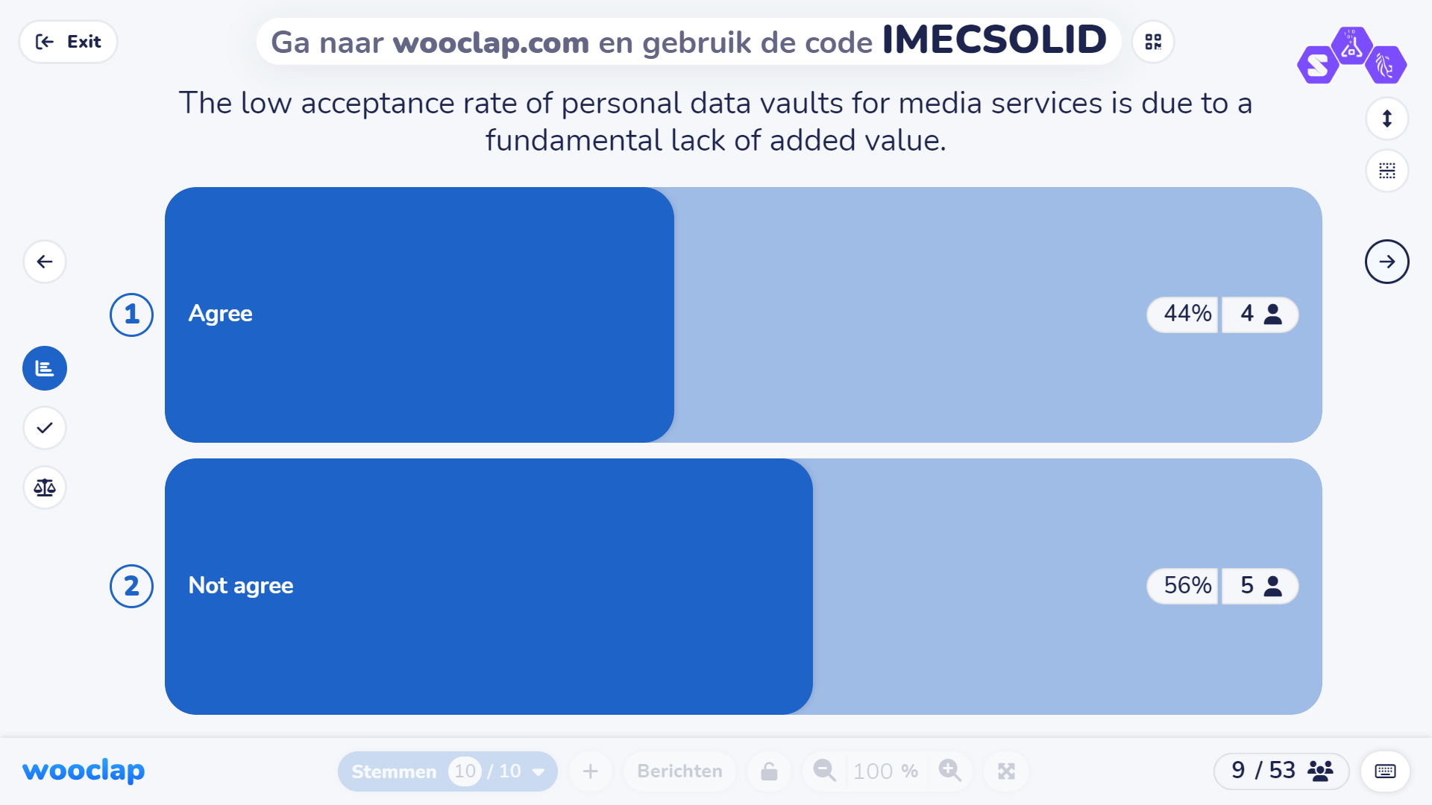
Taxonomy PDS
-> explaining what we want to learn from this and where we want to go

